Slide 1
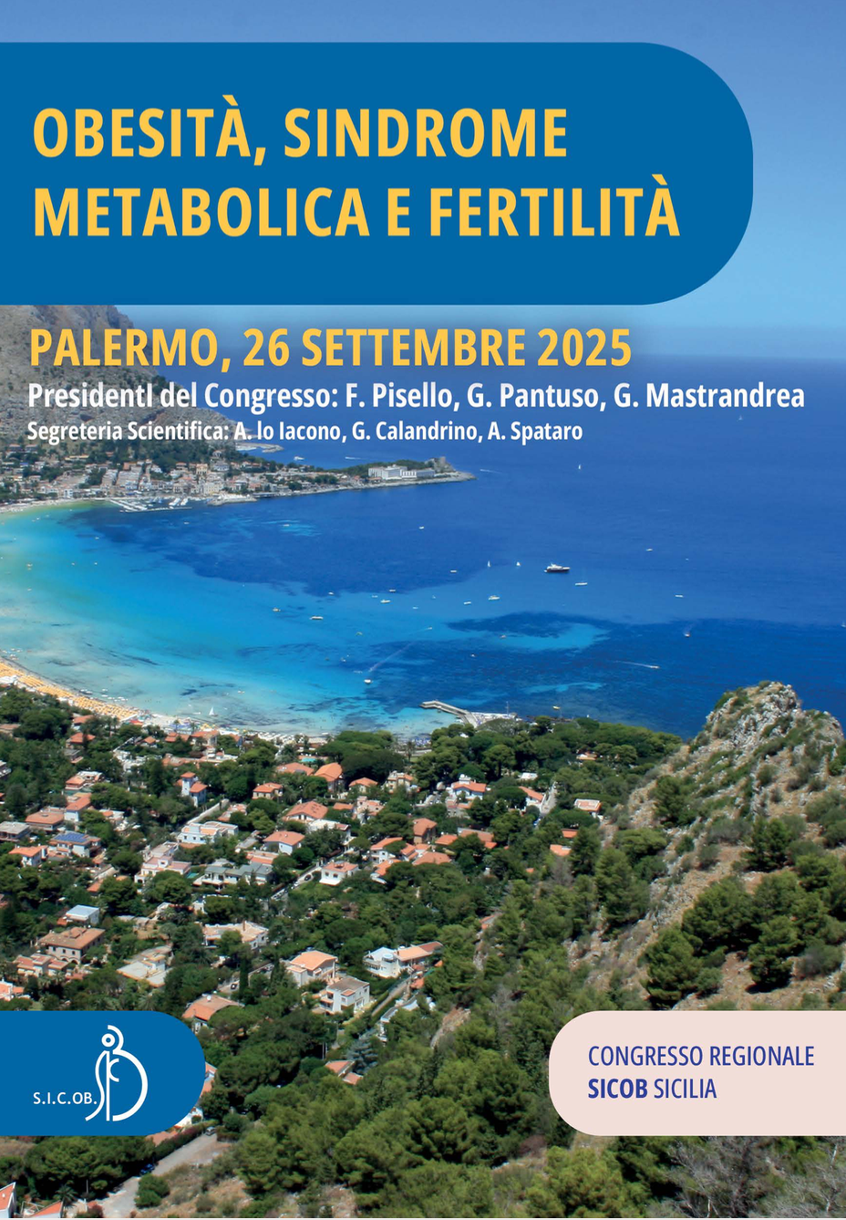
PCOS e infertilità in pazienti obese trattate con analoghi del GLP-1
Davide Brancato
UOC Medicina Interna
Centro di II livello
per il Trattamento Integrato dell’Obesità dell’adulto
CASA DI CURA CANDELA
Palermo

Slide 2
Il sottoscritto Davide Brancato in qualità di Responsabile Scientifico
ai sensi dell’art. 76, comma 4 dell'Accordo Stato-Regioni del 2 febbraio 2017 e del paragrafo 4.5. del Manuale nazionale di accreditamento per l'erogazione di eventi ECM dichiara di non aver avuto rapporti di finanziamento diretto con soggetti portatori di interessi commerciali in campo sanitario

Slide 3
Agenda
Dall’organo adiposo all’ABCD alla PCOS & Infertilità
Curare l’ABCD con gli agonisti recettoriali del GLP-1
Curare la PCOS & l’infertilità con gli agonisti recettoriali del GLP-1

Slide 4
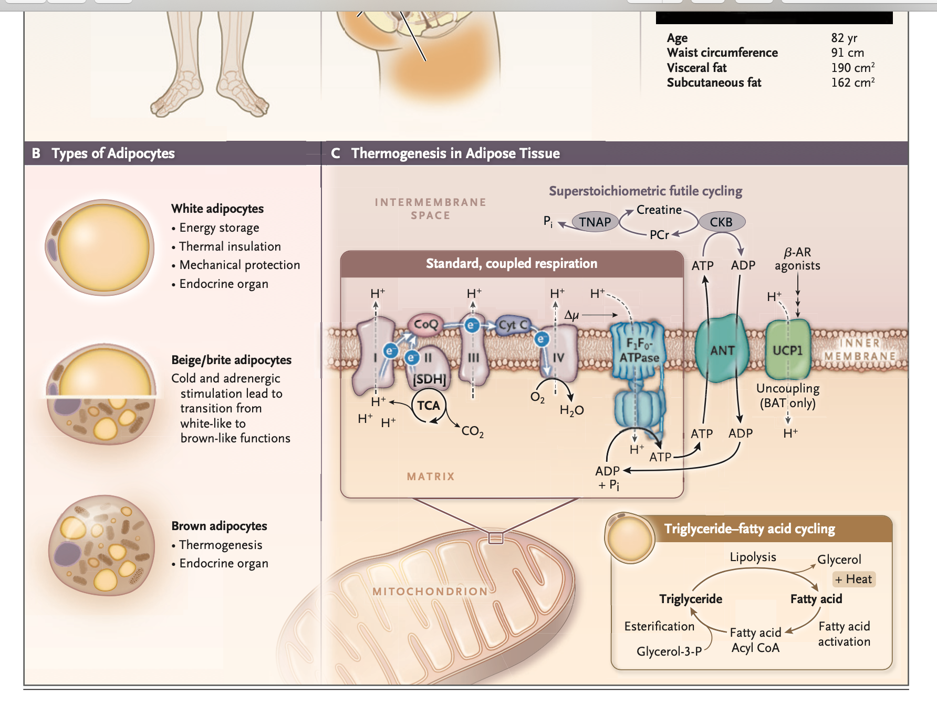
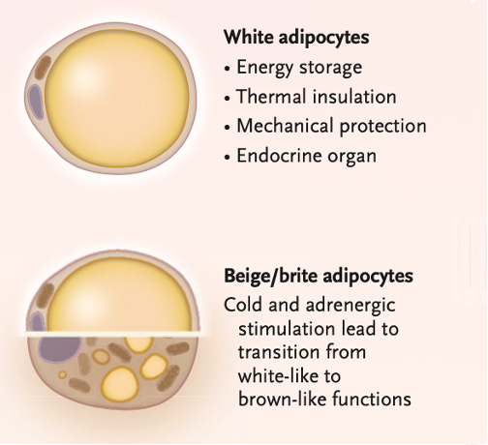
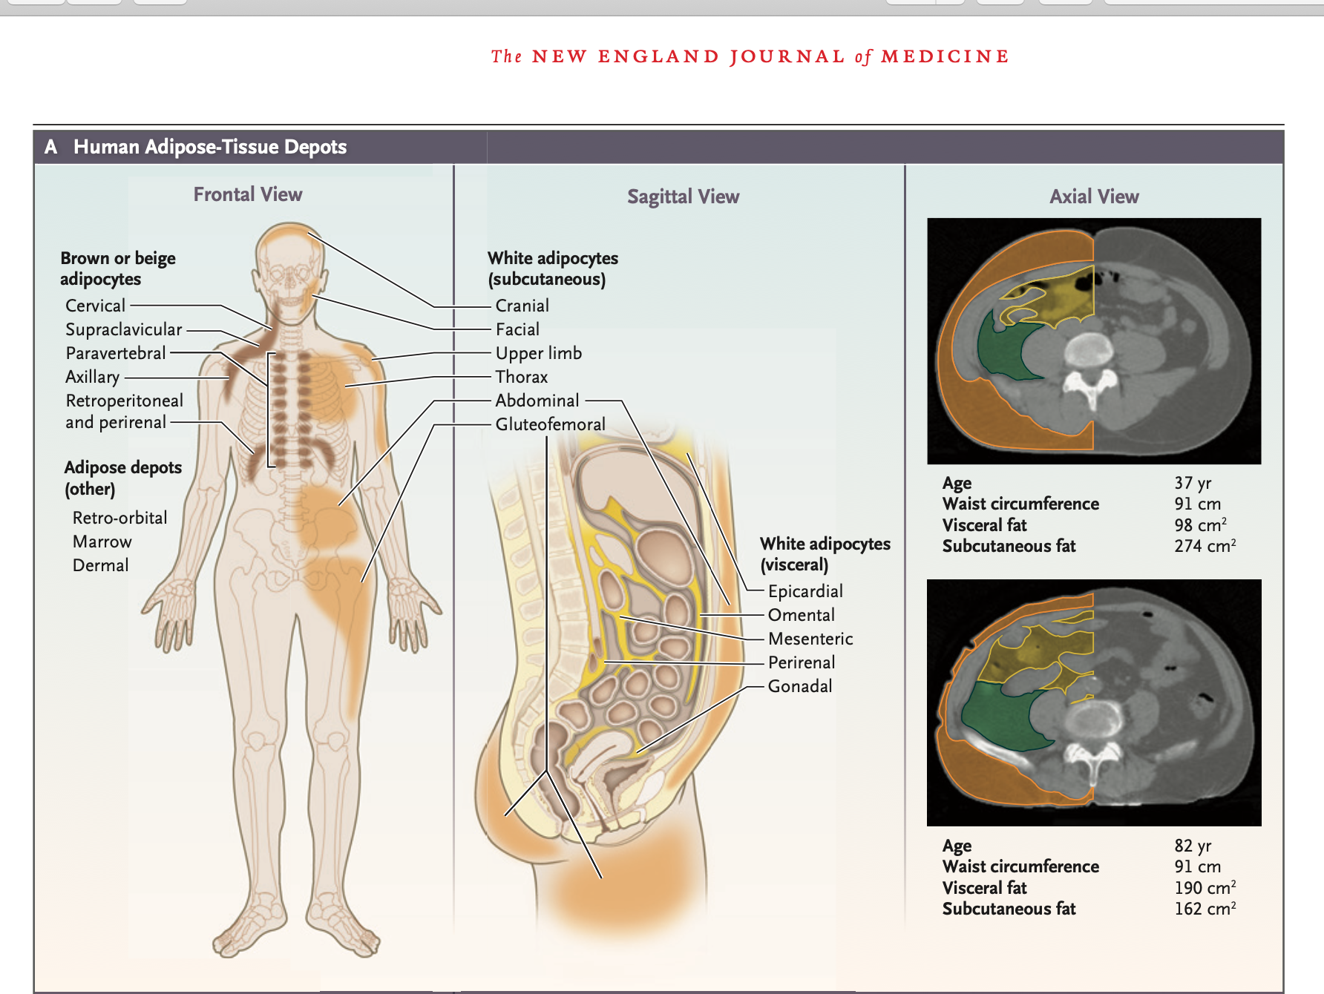
Tessuto adiposo: compartimentalizzazione anatomica
Brown
Adipose Tissue (BAT)
White
Adipose Tissue (WAT)
Subcutaneous
Adipose Tissue (SAT)
Visceral
Adipose Tissue (VAT)
E poi…Grasso ectopico:
tessuto adiposo mammario, intermuscolare ed intramuscolare, timico, midollare, pericardico, perivascolare, retro-orbitario, perigonadico…
steatosi epatica, cardiaca, muscolare, tiroidea, beta-cellulare…
Componenti cellulari
Adipociti maturi
Immunitarie: macrofagi, T (Th1/Th2/Treg), B, ILC2, NK...
Progenitori/preadipociti (ASCs), endoteliali e periciti
Fibroblasti/miofibroblasti (rimodellamento ECM)
Cellule di Schwann e fibre nervose
Mod.da: Cypess AM. N Engl J Med 2022;386:768-79
Notes:
NOTE:
grasso mammario, grasso intermuscolare ed intramuscolare, grasso timico, grasso midollare, grasso pericardico, grasso perivascolare, grasso retro-orbitario, (grasso perigonadico nel topo)
steatosi epatica, cardiaca, muscolare, tiroidea, beta-cellulare…(grasso ectopico)
Panel A shows the principal human adipose-tissue depots from the frontal (left) and sagittal (center) planes. Brown or beige depots are shown in brown, subcutane- ous white fat in orange, and visceral white fat in yellow. Panel A also shows CT scans, with axial views of the abdomen (right), in two men with the same waist circum- ference but different partitioning of the adipose-tissue depots. Orange indicates subcutaneous fat, green retro- peritoneal visceral fat, and yellow mesenteric visceral fat. The volumes of fat refer to the sum of both the left and right sides of the body.
Panel B shows the three principal types of adipocytes and their known physiological roles.

Slide 5
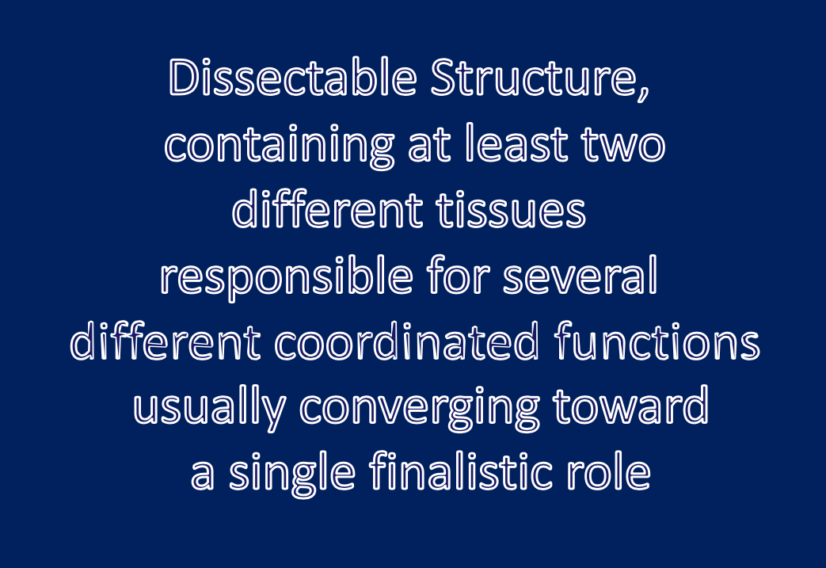
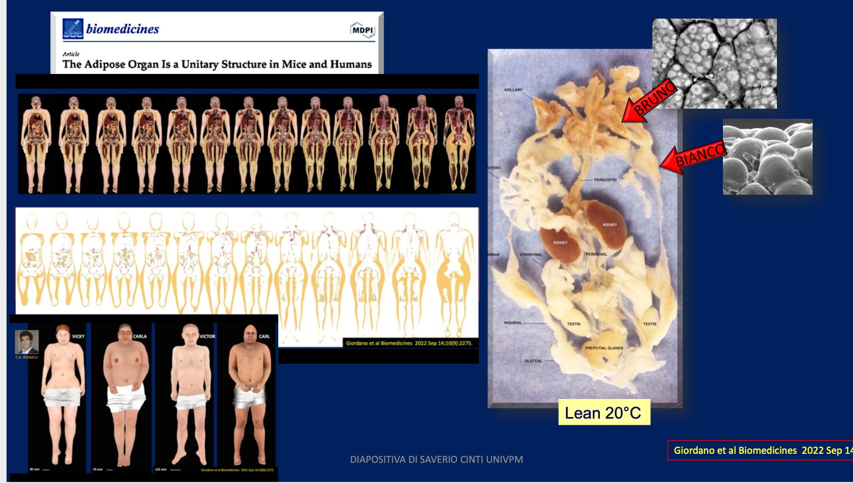
Tessuto adiposo = Organo Adiposo
Adipose organ functions
Energy storage (White Adipose Tissue, WAT)
Thermogenesis (Brown Adipose Tissue, BAT)
Mechanical prortection and theraml insulation
Regenerative (Stem cells)
Endocrine & Immune
Adipose organ functions
Energy storage (White Adipose Tissue, WAT)
Thermogenesis (Brown Adipose Tissue, BAT)
Mechanical prortection and theraml insulation
Regenerative (Stem cells)
Endocrine & Immune
Cinti, S. (2023). The adipose organ at a glance. *Disease Models & Mechanisms*, 16(3).
Notes:
NOTE:
grasso mammario, grasso intermuscolare ed intramuscolare, grasso timico, grasso midollare, grasso pericardico, grasso perivascolare, grasso retro-orbitario, (grasso perigonadico nel topo)
steatosi epatica, cardiaca, muscolare, tiroidea, beta-cellulare…(grasso ectopico)
Panel A shows the principal human adipose-tissue depots from the frontal (left) and sagittal (center) planes. Brown or beige depots are shown in brown, subcutane- ous white fat in orange, and visceral white fat in yellow. Panel A also shows CT scans, with axial views of the abdomen (right), in two men with the same waist circum- ference but different partitioning of the adipose-tissue depots. Orange indicates subcutaneous fat, green retro- peritoneal visceral fat, and yellow mesenteric visceral fat. The volumes of fat refer to the sum of both the left and right sides of the body.
Panel B shows the three principal types of adipocytes and their known physiological roles.

Slide 6
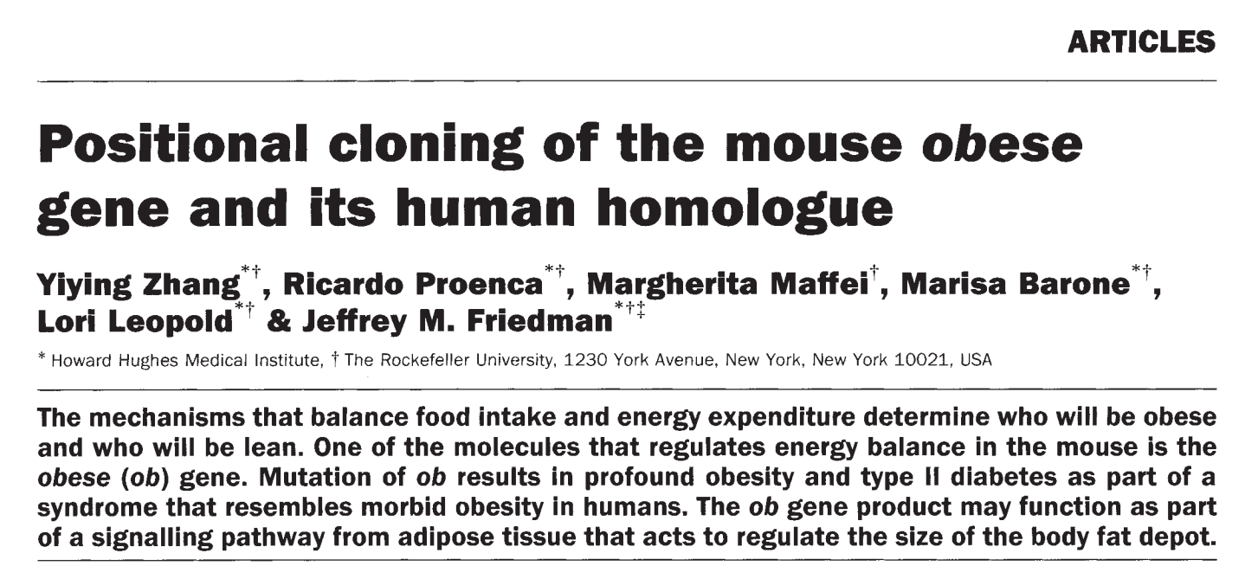
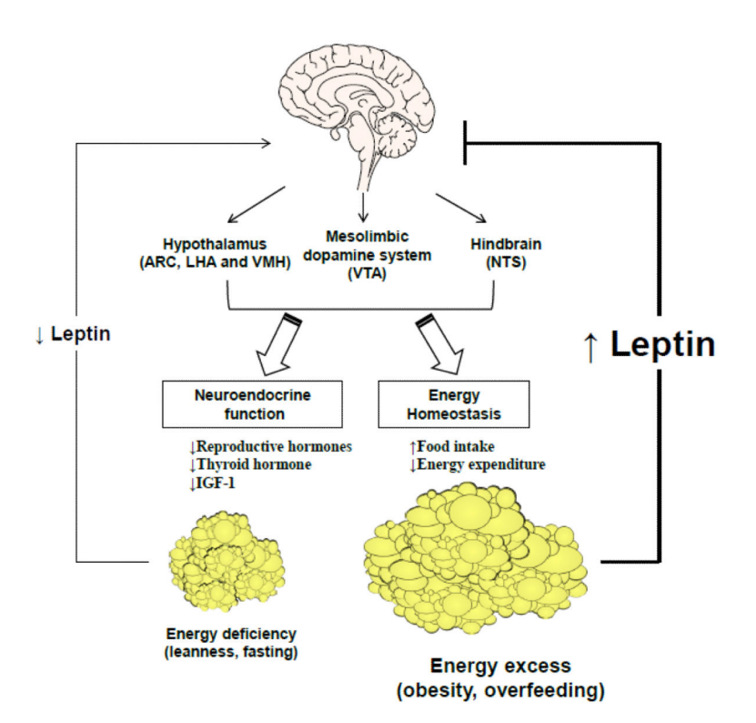
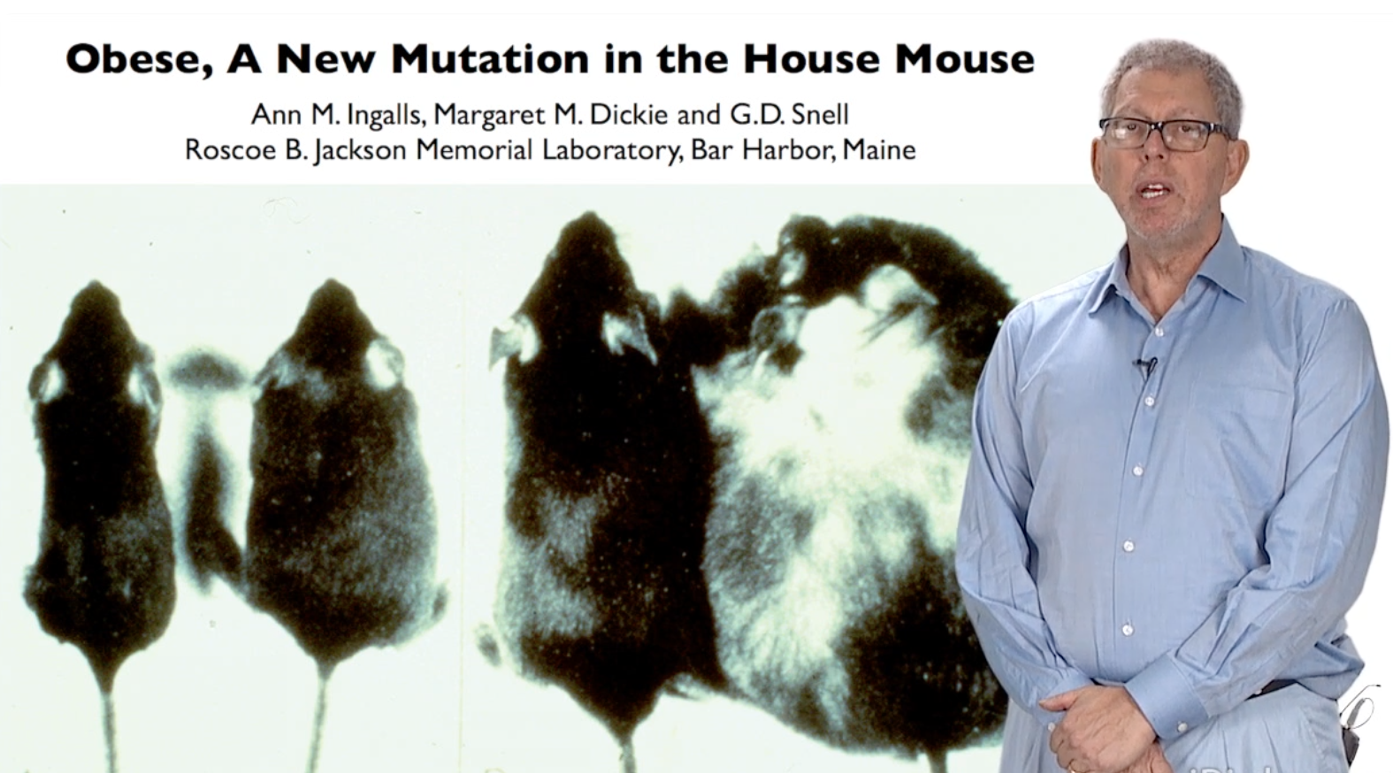

Organo adiposo: la rivoluzione della leptina
Tong, Q., Xu, Y. Curr Obes Rep 1, 236–244 (2012).
Zhang Y, et al.. Nature. 1994 Dec 1;372(6505):425-32.

Slide 7
Gli ormoni del tessuto adiposo
Factor | White | Brown/Beige | Preadipocytes | Macrophages | Endothelial | Immune | Target organ/tissue & action
Leptin | ++ | ++ | – | – | – | – | Hypothalamus, gonads, immune → ↓ appetite, reproduction, immune modulation
Adiponectin | ++ | ++ | – | – | – | – | Liver, muscle, heart → ↑ insulin sensitivity, anti-inflammatory
Asprosin | ++ | – | – | – | – | – | Liver → ↑ gluconeogenesis; Brain (hypothalamus) → ↑ appetite; Muscle → insulin resistance
Resistin | ++ | ++ | – | ++ | – | – | Liver, endothelium → insulin resistance, pro-atherogenic
Visfatin | ++ | – | – | – | – | – | Adipose tissue, immune cells → insulin-mimetic effects, inflammation, metabolic regulation
Adipsin | ++ | ++ | – | – | – | – | Complement, β-cells → complement activation, insulin secretion
FABP4 | ++ | ++ | – | ++ | ++ | – | Macrophages, liver → pro-inflammatory, insulin resistance
NRG4 | – | ++ | – | – | – | – | Liver → ↓ lipogenesis, NAFLD protection
CXCL14 | – | – | – | ++ | ++ | – | Immune cells → chemokine, immune cell recruitment
IL-6 | ++ | ++ | – | ++ | ++ | ++ | Liver, muscle, brain → pro-inflammatory, insulin resistance
FGF21 | – | ++ | – | – | – | → | Liver, muscle, brain → ↑ thermogenesis, ↑ insulin sensitivity
RBP4 | ++ | – | – | – | – | – | Liver, muscle → insulin resistance, metabolic dysfunction
Factor | White | Brown/Beige | Preadipocytes | Macrophages | Endothelial | Immune | Target organ/tissue & action
IGF-1 | – | – | – | ++ | – | – | Liver, bone, muscle → anabolic, growth
GDF15 | + | – | – | + | – | + | Hypothalamus → appetite ↓, anti-inflammatory
eNAMPT | ++ | – | – | ++ | – | ++ | β-cells, nervous tissue → NAD+ regulation, insulin secretion
Omentin | – | – | – | ++ | ++ | – | Endothelium, heart → insulin sensitizer, anti-inflammatory
Vaspin | ++ | – | – | – | – | – | Liver, muscle → insulin sensitizer, anti-inflammatory
Apelin | ++ | + | – | – | ++ | – | Endothelium, cardiovascular system, muscle → vasodilation, angiogenesis, improves insulin sensitivity,
Palmitoleate | ++ | – | – | – | – | – | Liver, muscle → lipokine, ↑ insulin sensitivity
DNL FAHFAs | ++ | – | – | – | – | – | β-cells, adipose tissue → anti-inflammatory, insulin secretion
12,13-diHOME | – | ++ | – | – | – | – | Muscle, BAT → ↑ FA uptake, thermogenesis
Exos miR-99b | ++ | – | – | – | – | – | Liver, muscle → glucose & lipid metabolism
Exos miR-92b | ++ | – | – | – | – | – | Endothelium, heart → angiogenesis, vascular function
Mod. da: Scheja L. et al.. Nat Rev Endocrinol 2019; 15: 507–524.
Notes:
MESSAGGI:
l’organo adiposo è composto non soltanto da adipociti (ma anche da cellule progenitrici, macrofagi, linfociti, cellule endoteliali)
l’organo adiposo è la più grande e complessa ghiandola endocrina dell’organismo
In addition to their role in glucose and lipid metabolism, adipocytes respond differentially to physiological cues or metabolic stress by releasing endocrine factors that regulate diverse processes, such as energy expenditure, appetite control, glucose homeostasis, insulin sensitivity, inflammation and tissue repair. Both energy-storing white adipocytes and thermogenic brown and beige adipocytes secrete hormones, which can be peptides (adipokines), lipids (lipokines) and exosomal microRNAs. Some of these factors have defined targets; for example, adiponectin and leptin signal through their respective receptors that are expressed in multiple organs. For other adipocyte hormones, receptors are more promiscuous or remain to be identified. Furthermore, many of these hormones are also produced by other organs and tissues, which makes defining the endocrine contribution of adipose tissues a challenge. In this Review, we discuss the functional role of adipose tissue-derived endocrine hormones for metabolic adaptations to the environment and we highlight how these factors contribute to the development of cardiometabolic diseases. We also cover how this knowledge can be translated into human therapies. In addition, we discuss recent findings that emphasize the endocrine role of white versus thermogenic adipocytes in conditions of health and disease.Adipocytes respond to environmental cues, such as metabolic stress, by releasing endocrine factors that modulate diverse physiological processes. This Review discusses the metabolic functions of adipose tissue-derived endocrine hormones and highlights how these factors might contribute to cardiometabolic diseases.Key pointsWhite and brown adipocytes secrete many peptide hormones (adipokines), bioactive lipids (lipokines) and RNA molecules with local (paracrine) and systemic (endocrine) effects on the brain, pancreatic β-cells, the liver, skeletal muscle and the cardiovascular system. Production and secretion of adipokines and lipokines is dependent on the energy status of adipose tissues. Through endocrine action, these factors contribute to systemic energy metabolism by regulating appetite, thermogenesis, glucose metabolism and lipid metabolism.Many peptides that were initially described as adipokines are secreted by endothelial and immune cells located in adipose tissues, as well as by other organs, which means the endocrine contribution of adipocytes can be difficult to ascertain.In healthy states, white and brown adipose tissues secrete endocrine factors that maintain organ functions and metabolic homeostasis.In obesity, hypertrophic adipocytes and adipose tissue-resident immune cells accelerate a chronic, proinflammatory profile with altered secretion of adipokines and lipokines, thereby exacerbating cardiometabolic disease.Preclinical and clinical studies show that activating or inhibiting the signalling of specific adipokines or lipokines could be an approach suitable to treat or prevent the development of cardiometabolic diseases. However, in almost all cases, efficacy and safety in humans needs to be proven.

Slide 8

Organo adiposo: organo endocrino «al centro»
dell’omeostasi energetica e riproduttiva
Energy
Energy intake and expenditure
🧠 Brain
Hypothalamic & pituitary hormones
Reproduction
GnRH pulse generator
♀️
🩸 Liver
Hepatokines,
glucose/lipid metabolism
🟡 Adipose tissue
Adipokines, Batokines, miRNAs
Iinterleukins
💪 Skeletal
muscle
Myokines
🧩 Pancreas
Insulin, glucagon, incretins
🦠 Gut & Microbiota
Gut hormones, microbial metabolites

Slide 9
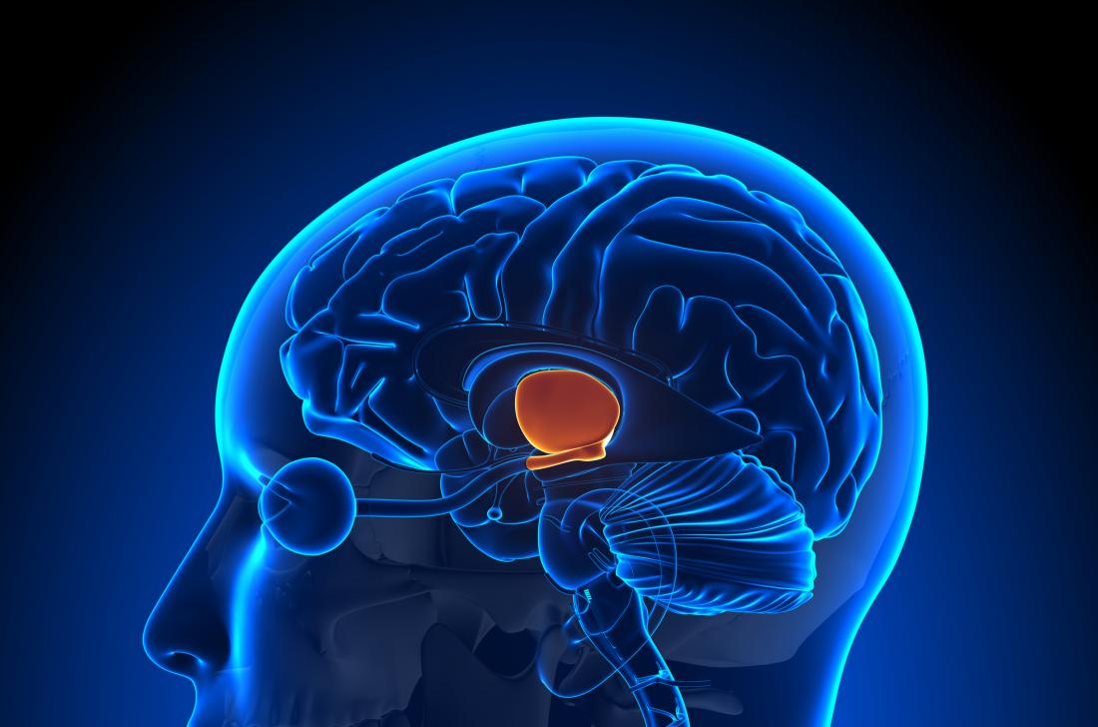
Organo adiposo come modulatore
dell’omeostasi energetica – ruolo della leptina
Energy intake
Energy expenditure
MCR-4
Paraventricular Nucleus
(PVN)
Satiety
Hunger
POMC/ CART
NPY/ AgRP
Arcuate nucleus (ARC)
Leptin
AgRP, Agouti-related peptide; CART, cocaine- and amphetamine-regulated transcript; NPY, neuropeptide Y; POMC, pro-opiomelanocortin; melanocortin-4 receptor (MC4R)
🟡 Adipose tissue
Secher et al. J Clin Invest 2014;124:4473–88;
van Can et al. Int J Obes (Lond) 2014;38:784–93

Slide 10
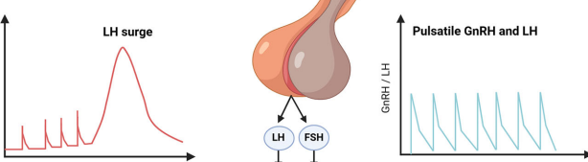
Organo adiposo come modulatore
dell’omeostasi riproduttiva – ruolo della leptina
GnRH (and LH) pulsatility
MCR-4
Median
Eminence
Kisspeptin
Kisspeptin/Neurokinin B /Dynorphin (KNDy) Neurons
Arcuate Nucleus (ARC)
Leptin
🟡 Adipose tissue
Patel AH, et al. Ann N Y Acad Sci. 2024 Oct;1540(1):21-46.

Slide 11
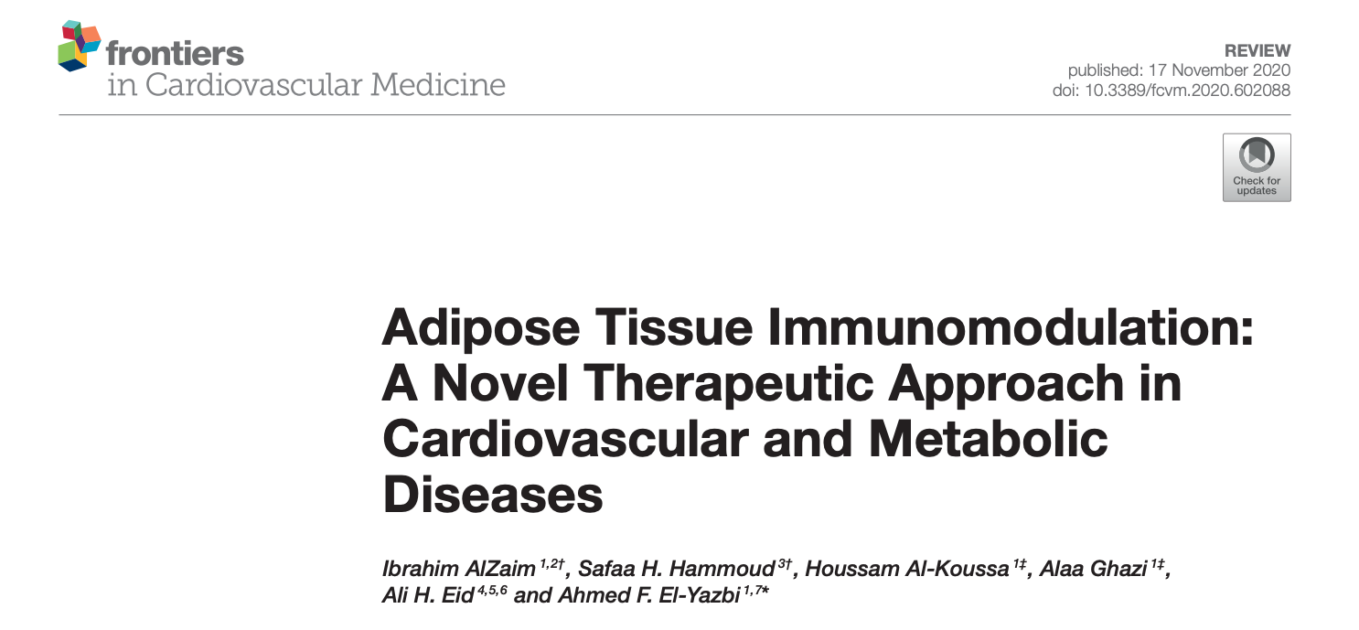
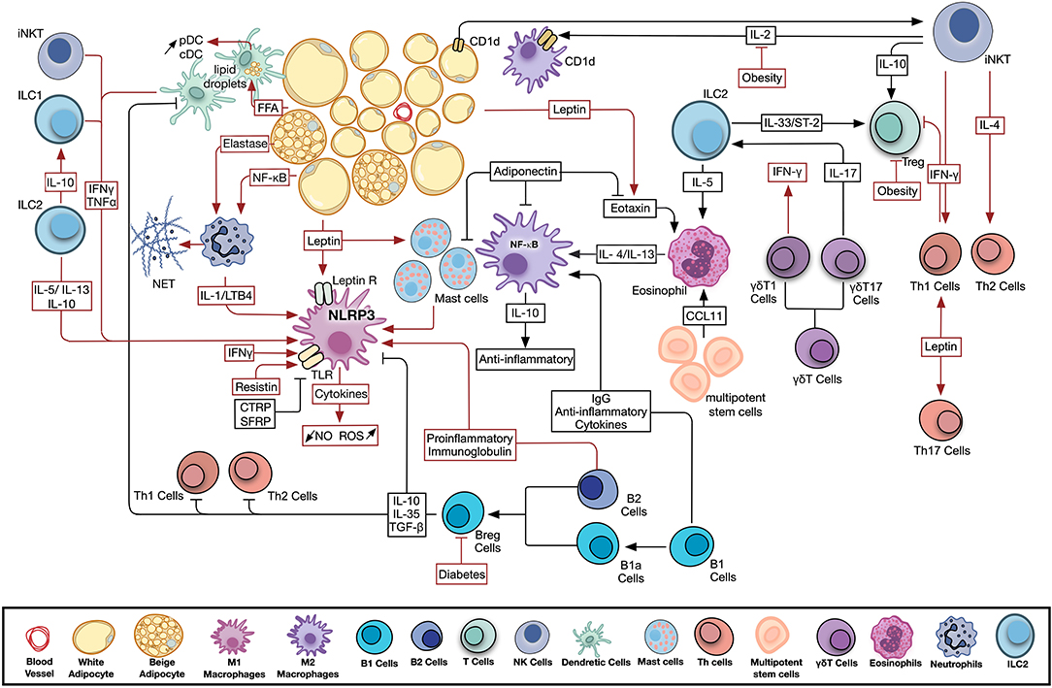
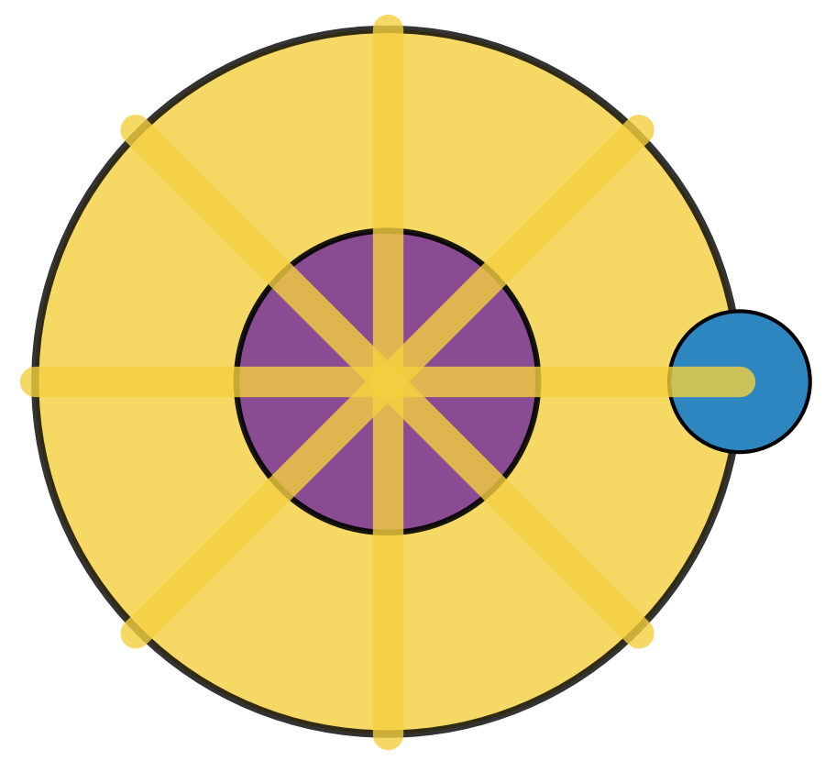
Organo adiposo: organo immunologico «al centro»
dell’immunomodulazione e della flogosi
🟡 Adipocytes + Macrophages + 🧬 T/B cells
➡️ Release: TNF-α, IL-6, MCP-1…
🔥 Local and systemic inflammation
Alzaim I et al. Front. Cardiovasc. Med., 17 November 2020 Sec. Cardiovascular Therapeutics
Notes:
Figure 1. Adipose tissue resident and infiltrating immune cells activity in health and disease. Significant crosstalk exists among adipocytes, adipokines, and resident and infiltrating, innate and adaptive immune cells. Metabolic disease conditions modulate the adipokine profile and immune cell activity leading to the observed chronic low-grade inflammation. Pathways involved in AT homeostasis are depicted in black arrows, while those activated by metabolic dysfunction are shown in red. B Cell, B Lymphocyte; Breg Cells, Regulatory B Lymphocyte; CCL11, C-C motif chemokine 11; CD1d, Cluster of Differentiation 1d; cDC, Conventional Dendritic Cell; FFA, Free Fatty Acids; IFNγ, Interferon Gamma; IgG, Immunoglobulin G; IL, Interleukin; ILC, Innate Lymphoid Cell; iNKT Cell, Invariant Natural Killer T Cell; LTB4, Leukotriene B4; NET, Neutrophil Extracellular Trap; NF-κB, Nuclear Factor Kapp-light-chain-enhancer of Activated B cells; NLRP3, NLR Family Pyrin Domain Containing 3; NO, Nitric Oxide; pDC, Plasmacytoid Dendritic Cell; ROS, Reactive Oxygen Species; T Cell, T Lymphocyte; TGF-β, Transforming Growth Factor Beta; Th Cell, Helper T Lymphocyte; TLR, Toll Like Receptor; TNFα, Tumor Necrosis Factor Alpha; Treg, Regulatory T Lymphocyte.

Slide 12
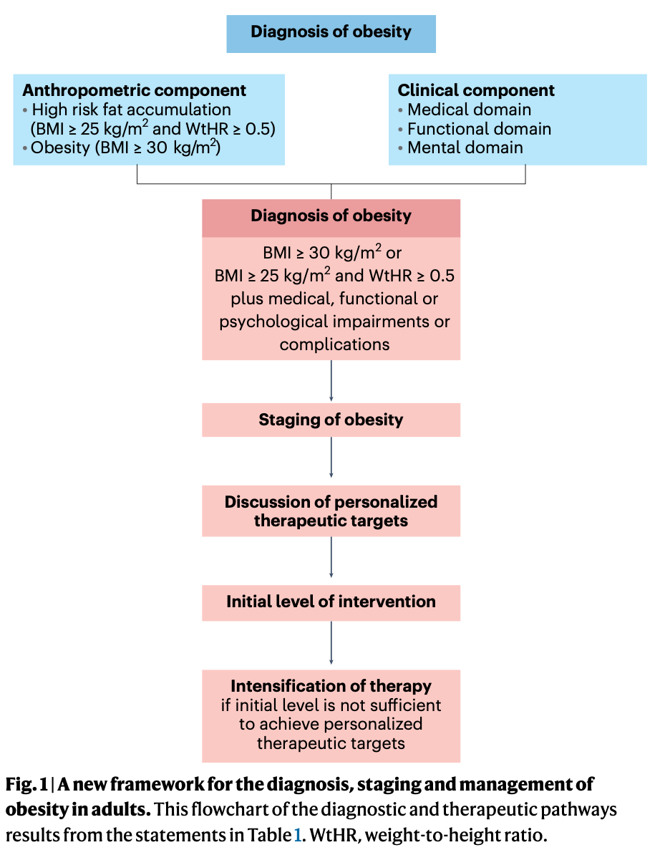
EASO 2024 Consensus Key Concepts
Obesità ovvero Adiposity Based Chronic Disease – oltre il BMI
Obesity is recognized as an adiposity-based chronic disease (ABCD)
→ Adipose Organ hypertrophic, maldistributed, dysfunctional
Diagnosis requires anthropometric (BMI, WtHR) + clinical (medical, functional, mental) components
WtHR > 0.5 as a superior marker of visceral adiposity
Staging based on severity of medical, functional, and mental complications
Treatment pillars: Lifestyle, psychological therapy, pharmacotherapy, metabolic/bariatric surgery
Therapeutic targets beyond weight loss: prevention/improvement of complications, QoL, function
Personalized, long-term, multidisciplinary management approach
Busetto L, et al. Nat Med. 2024; doi:10.1038/s41591-024-03095-3
Notes:
Questa slide riassume i punti chiave della consensus EASO 2024. Definisce l’obesità come malattia cronica basata sull’adiposità, integra valutazioni antropometriche e cliniche, sottolinea il WtHR > 0,5 come marker di adiposità viscerale, e propone una stadiazione basata sulla gravità. Il trattamento è multidimensionale e personalizzato, con obiettivi oltre la perdita di peso.

Slide 13
Lancet Diabetes Commission Consensus 2025 Key Concepts
Obesità ovvero Eccesso di tessuto adiposo – oltre il BMI
Obesity = excessive adiposity, with or without abnormal distribution or function of the adipose
BMI alone is insufficient to diagnose obesity due to misclassification risk
Confirmation of excess body fat via BMI, body size measures, or direct measurement (e.g., DEXA)
Diagnosis distinguishes between preclinical and clinical obesity
Preclinical obesity: excess body fat without organ dysfunction or daily activity limitation
Clinical obesity: excess body fat with organ dysfunction and/or reduced daily activity
Management focus: risk reduction for preclinical, functional improvement for clinical obesity
Success measured by improvement in signs/symptoms, not only weight loss
Rubino F, et al.. Lancet Diabetes Endocrinol. 2025 Mar;13(3):221-262. doi: 10.1016/S2213-8587(24)00316-4.
Notes:
Questa slide riassume i punti chiave del documento 2025 sulla definizione e criteri diagnostici di obesità clinica. Si evidenzia come il BMI da solo sia inadeguato per la diagnosi, proponendo la distinzione tra obesità preclinica e clinica. La diagnosi richiede la conferma dell’eccesso di grasso corporeo con misure corporee o metodi diretti come la DEXA. La gestione si differenzia tra le due categorie, con obiettivi di riduzione del rischio nella fase preclinica e di miglioramento funzionale nella fase clinica. Il successo terapeutico viene valutato sulla base del miglioramento clinico, non solo sulla perdita di peso.

Slide 14
ABCD framework: massa, distributione, funzione — meccanismi, biomarkers, impatto clinico
ABCD dimension | Core mechanisms | Biomarkers / indices | Clinical impact
Mass (↑ adiposity) | Adipocyte hypertrophy Hypoxia ER/oxidative stress Senescence | BMI, %BF, RFM, BRI leptin↑, adiponectin↓ | Insulin resistance, T2D Fatty liver disease Hypertension
Distribution (visceral/ectopic) | Vascular rarefaction Lipotoxicity (FFAs) | Waist circumference Waist to height ratio (WtHR) DEXA, CT, MRI VAT | Insulin resistance, T2D Atherosclerosis OSAS PCOS
Function - endocrine | Leptin resistance ↓ adiponectin resistin/visfatin/asprosin | Leptin↑, Adiponectin↓ HOMA‑IR↑ ALT/steatosis indices | Dyslipidemia Fatty liver disease
Function - immune | ATM shift M2→M Treg↓, Th1/Th17↑ cytokines↑ | TNF‑α, IL‑6, MCP‑1↑ hsCRP↑ CLS on histology | Metaflammation Endothelial dysfunction Coronary Artery Disease
Key sources: Tseng Y-H et al., Nat Rev Endocrinol 2023; Burak MF et al., Am J Clin Nutr 2024; Mączka K et al., Int J Mol Sci 2024; Nadolsky K et al., Endocr Pract 2025.

Slide 15
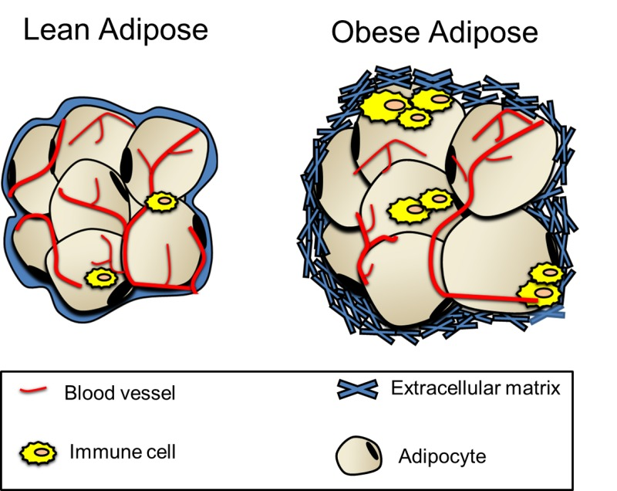
Organo adiposo nell’ABCD: disfunzione endocrina & immunonologica
Endocrine dysfunction
• ↑ Leptin (resistance)
• ↑ Resistin, visfatin, asprosin
• ↓ Adiponectin
• ↑ FFAs, ceramides
Drivers of dysfunction
• Nutrient excess
• Microbiome dysbiosis
• Adipocyte hypertrophy
• Visceral/ectopic fat expansion
• Hypoxia, ER/oxidative stress
Adipose Organ (ABCD) • Mass
• Distribution
• Function
Immune dysfunction
• ATM shift: M2 → M1, CLS formation
• Treg↓, Th1/Th17↑; ILCs, B cells
• Cytokines: TNF-α, IL-6, MCP-1
Downstream complications
• Insulin resistance, T2D, NAFLD
• Hypertension, atherosclerosis
• Cancer
• Reproductive dysfunction, PCOS-independent anovulation
• Sleep apnea, osteoarthritis
Key sources: Tseng Y-H et al., Nat Rev Endocrinol 2023; Burak MF et al., Am J Clin Nutr 2024; Mączka K et al., Int J Mol Sci 2024; Nadolsky K et al., Endocr Pract 2025.

Slide 16
ABCD, PCOS & infertilità — meccanismi, biomarkers, impatto clinico
ABCD dimension | Core mechanisms | Biomarkers / indices | Clinical impact
Mass (↑ adiposity) | Adipocyte hypertrophy Hypoxia, ER/oxidative stress Lipotoxicity (FFAs, ceramides) Adipokine imbalance | ↑ Leptin, ↓ Adiponectin BMI, %BF HOMA-IR↑ | Hyperinsulinemia ↑ androgens ↓ SHBG Anovulation
Distribution (visceral/ectopic) | Visceral/ectopic fat expansion Vascular rarefaction Ectopic fat (hepatic, ovarian, endometrial) | Waist circumference, WtHR DEXA, CT, MRI VAT Liver/skeletal muscle fat indices | PCOS phenotype Oligo-anovulation ↑ infertility risk
Function – endocrine | Leptin resistance ↓ Adiponectin ↑ Resistin, Visfatin, Asprosin | ↑ Leptin, ↓ Adiponectin Adipokine panels FFA spillover | Altered folliculogenesis Hyperandrogenism Reduced oocyte quality
Function – immune | ATM shift (M2→M1) ↓ Treg, ↑ Th1/Th17 ↑ TNF-α, IL-6, MCP-1 CLS formation | Cytokines (TNF-α, IL-6, MCP-1) ↑ hsCRP CLS on histology | Ovarian/endometrial inflammation ↓ Endometrial receptivity ↓ Pregnancy rates, ART outcomes
Key sources: Bril F et al., JCEM 2023; Zheng L et al., Front Endocrinol 2024; Palomba S et al., Biomedicines 2024; Dai M et al., Endocrinology 2024; Schon SB et al., Fertil Steril 2024.

Slide 17
Organo adiposo nell’ABCD: disfunzione riproduttiva femminile
Endocrine dysfunction
• ↑ Leptin (resistance)
• ↑ Resistin, visfatin, asprosin
• ↓ Adiponectin
• ↑ FFAs, ceramides
Drivers of dysfunction
• Nutrient excess
• Microbiome dysbiosis
• Adipocyte hypertrophy
• Visceral/ectopic fat expansion
• Hypoxia, ER/oxidative stress
Adipose Organ (ABCD) • Mass
• Distribution
• Function
Immune dysfunction
• ATM shift: M2 → M1, CLS formation
• Treg↓, Th1/Th17↑; ILCs, B cells
• Cytokines: TNF-α, IL-6, MCP-1
Female reproductive dysfunctions
• Hyperinsulinemia/IR → ↑ androgeni, ↓ SHBG
• Anovulation; reduced oocyte quality
• Altered endometrial receptivity
• Worsened outcomes in assisted reproduction
Key sources: Bril F et al., JCEM 2023; Zheng L et al., Front Endocrinol 2024; Palomba S et al., Biomedicines 2024; Dai M et al., Endocrinology 2024; Schon SB et al., Fertil Steril 2024.

Slide 18
Ruolo della leptina nella PCOS & infertilità
Energy intake
Energy expenditure
MCR-4
Paraventricular Nucleus
(PVN)
Satiety
Hunger
POMC/ CART
NPY/ AgRP
Arcuate nucleus (ARC)
Leptin
AgRP, Agouti-related peptide; CART, cocaine- and amphetamine-regulated transcript; NPY, neuropeptide Y; POMC, pro-opiomelanocortin; melanocortin-4 receptor (MC4R)
🟡 Adipose tissue
Secher et al. J Clin Invest 2014;124:4473–88;
van Can et al. Int J Obes (Lond) 2014;38:784–93

Slide 19
Organo adiposo come modulatore
dell’omeostasi riproduttiva – ruolo della leptina
GnRH (and LH) pulsatility
MCR-4
Median
Eminence
Kisspeptin
Kisspeptin/Neurokinin B /Dynorphin (KNDy) Neurons
Arcuate Nucleus (ARC)
Leptin
🟡 Adipose tissue
Patel AH, et al. Ann N Y Acad Sci. 2024 Oct;1540(1):21-46.

Slide 20
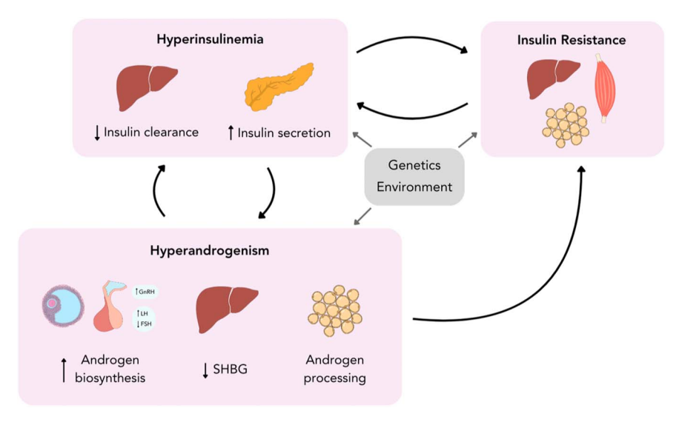
Ruolo centrale dell’insulino-resistenza/iperinsulinismo nella PCOS
PCOS phenotype | Ovulatory dysfunction | Hyperandrogenism | Polycystic ovarian morphology | hyperinsulinemia (Ezeh et al. 2022) | prevalence of insulin resistance (Moghetti et al. 2013)
A | ✓ | ✓ | ✓ | ✓ | 80%
B | ✓ | ✓ |  | ✓ | 80%
C |  | ✓ | ✓ | ✓ | 65%
D | ✓ |  | ✓ |  | 38%
Granulosa dysfunction (↓ aromatase) → impaired follicle selection
Theca cells → ↑ androgen synthesis (↑ CYP17A1, amplifies LH action)
Houston EJ, et al. J Endocrinol. 2025 Mar 12;265(2):e240269.

Slide 21
Agenda
Dall’organo adiposo all’ABCD alla PCOS & Infertilità
Curare l’ABCD con gli agonisti recettoriali del GLP-1
Curare la PCOS & l’infertilità con gli agonisti recettoriali del GLP-1

Slide 22
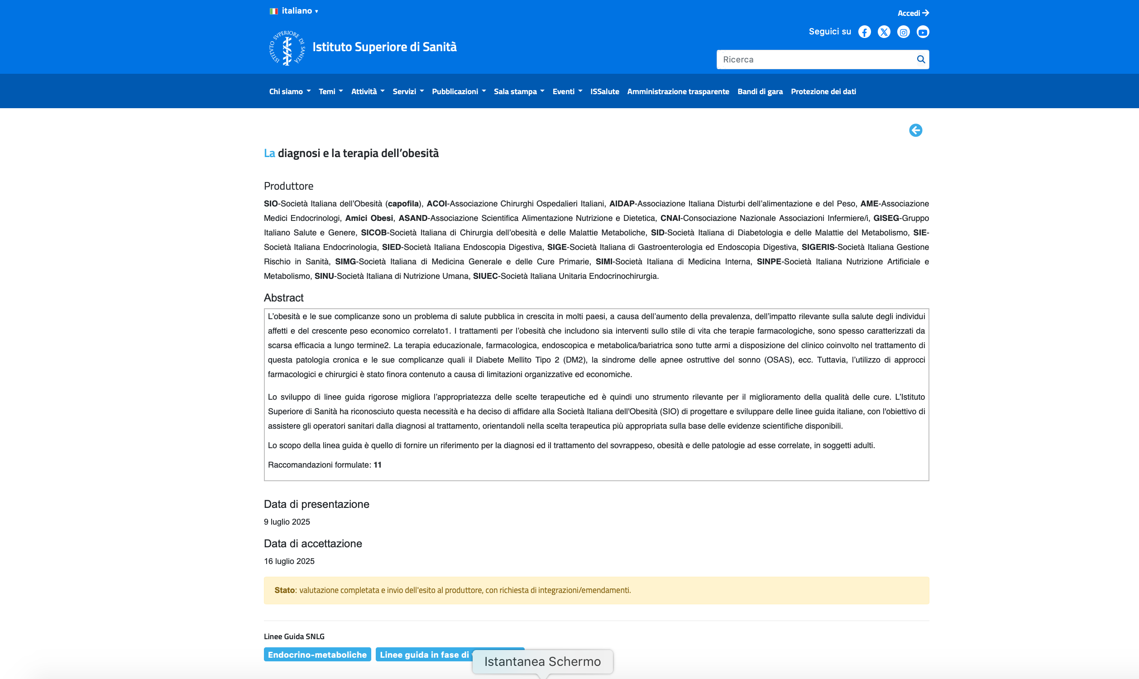
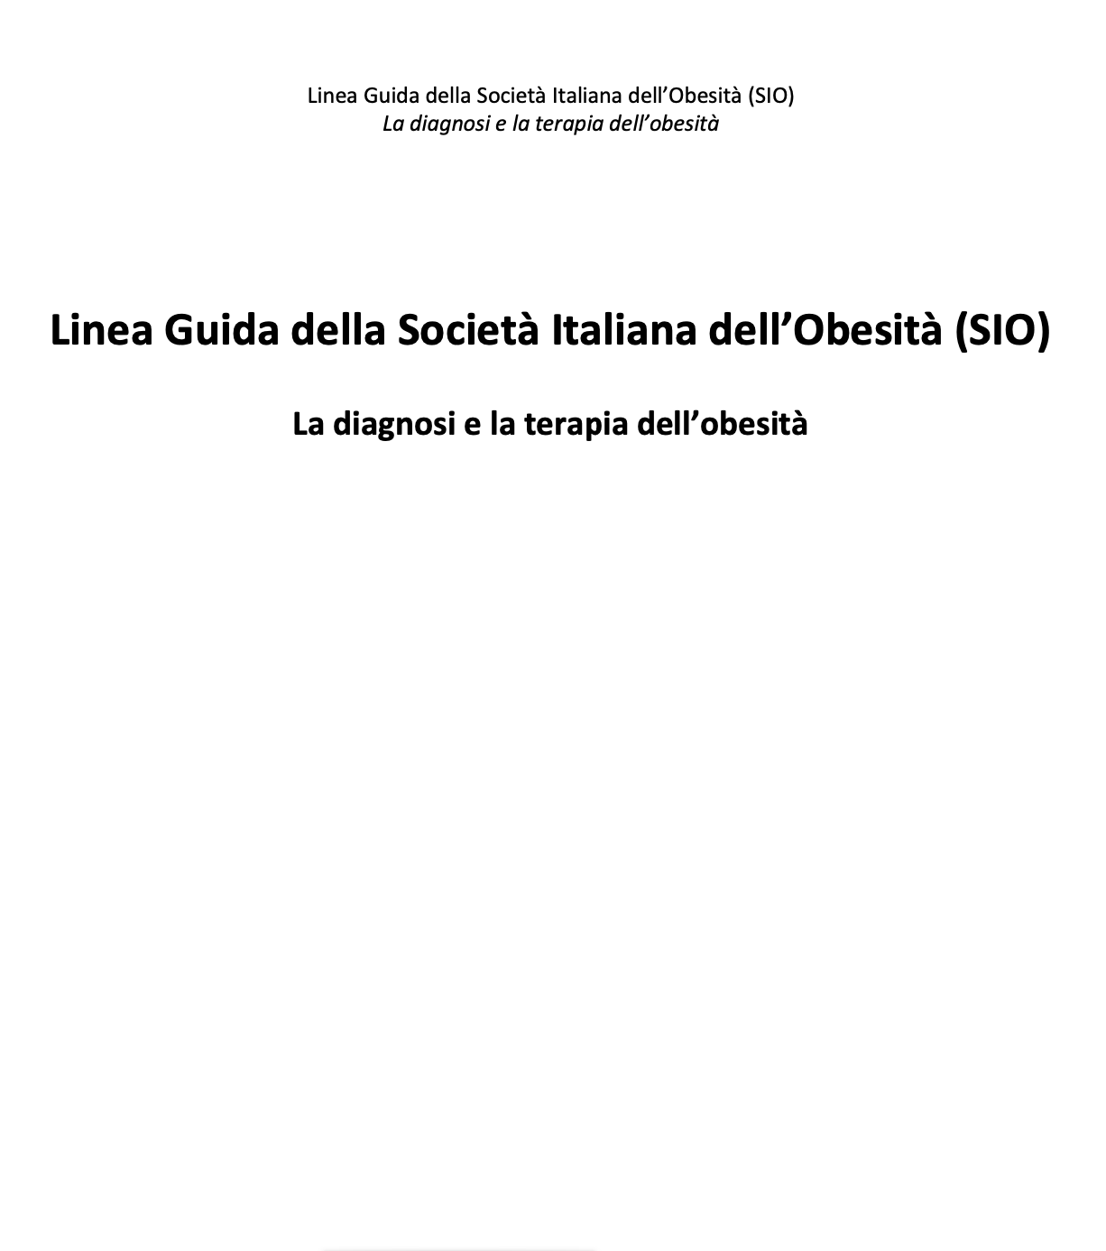
SNLG 2025 La diagnosi e la terapia dell’obesità

Slide 23
SIO 2025 - Sintesi delle Raccomandazioni
Criteri Diagnostici
PICO / Tema | Raccomandazione | Forza | Qualità
👥 PICO 1–3 Nelle persone con BMI tra 25-34,9 kg/m2, la misurazione della circonferenza della vita e/o del rapporto vita/fianchi, e/o del rapporto circonferenza vita/altezza è preferibile rispetto a quella del solo BMI, per la stadiazione del rischio di complicanze associate all’obesità? | Si raccomanda di utilizzare altri indici antropometrici, tra i quali la circonferenza della vita, rispetto al solo calcolo del BMI per una migliore diagnosi e stadiazione del rischio clinico associato all’obesità. | Forte | Molto bassa
👥 PICO 4 Nelle persone con BMI tra 25-34.9 kg/m2, la valutazione della composizione corporea con metodi strumentali è preferibile rispetto a non eseguirla (usando solo indici antropometrici), per la stadiazione del rischio clinico associato all’obesità? | Non si suggerisce di utilizzare routinariamente metodiche invasive per la determinazione della massa grassa rispetto all’utilizzo dei soli indici antropometrici per una migliore stadiazione del rischio clinico legate all’obesità | Debole | Molto bassa
SIO 2025

Slide 24
SIO 2025 - Sintesi delle Raccomandazioni
Terapia medico-Nutrizionale
PICO / Tema | Raccomandazione | Forza | Qualità
📚 PICO 5 Nelle persone con BMI> 25 kg/m2, un intervento educativo strutturato è preferibile rispetto a semplici consigli (intervento educativo non strutturato), per il trattamento del sovrappeso e obesità? | Si raccomandano interventi educativi strutturati rispetto ai soli consigli educazionali non strutturati, per il trattamento del sovrappeso e obesità. | Forte | Moderata
🧠 PICO 6 Nelle persone con BMI> 25 kg/m2, gli interventi educativi ad impronta cognitivo- comportamentale sono preferibili rispetto ad altre tipologie di intervento (o “standard of care”), per il trattamento del sovrappeso e obesità? | Si raccomandano interventi educativi ad impronta cognitivo-comportamentale rispetto ad altre tipologie educazionali (o nessun intervento) per il trattamento del sovrappeso e obesità. | Forte | Moderata
SIO 2025

Slide 25
SIO 2025 - Sintesi delle Raccomandazioni
Terapia medico-Nutrizionale
PICO / Tema | Raccomandazione | Forza | Qualità
🥗 PICO 7 Nelle persone con BMI> 25 kg/m2, le diete chetogeniche sono preferibili rispetto a quelle bilanciate (dieta mediterranea), per il trattamento del sovrappeso e obesità? | Non si consiglia l’impiego preferenziale di diete chetogeniche, rispetto a diete bilanciate, per il trattamento del sovrappeso e dell’obesità. | Debole | Molto bassa
🍎 PICO 8: Nelle persone con BMI> 25 kg/m2, gli interventi educativi strutturati comprendenti esercizio fisico combinato aerobico e di resistenza sono preferibili rispetto ad interventi educativi strutturati comprendenti solo esercizio di tipo aerobico, per il trattamento del sovrappeso e obesità? | All’interno di un programma medico-nutrizionale, non si dispone di evidenze che consentano di preferire interventi comprendenti esercizio fisico combinato rispetto ad interventi comprendenti solo esercizio fisico di tipo aerobico, per il trattamento del sovrappeso e obesità. | Debole | Bassa
SIO 2025

Slide 26
SIO 2025 - Sintesi delle Raccomandazioni
Terapia farmacologica/chirurgica/endoscopica
PICO / Tema | Raccomandazione | Forza | Qualità
💊PICO 9 Nelle persone con indice di massa corporea tra 27 e 29,9 kg/m2 con complicanze o condizioni associate all’obesità, il trattamento farmacologico (con farmaci approvati da EMA per il trattamento dell’obesità) in associazione a terapia medico-nutrizionale è preferibile rispetto alla sola terapia medico-nutrizionale, per il trattamento del sovrappeso? | Si consiglia di trattare farmacologicamente, in associazione a terapia medico-nutrizionale, le persone con BMI tra 27 e 29,9 kg/m2 e complicanze legate all’obesità rispetto alla sola terapia medico-nutrizionale. | Debole | Molto bassa
💊PICO 10 Nelle persone con indice di massa corporea tra 30 e 34,9 kg/m2, quali strategie tra quelle farmacologiche (farmaci approvati da EMA per il trattamento dell’obesità), chirurgiche o endoscopiche, in associazione a terapia medico-nutrizionale, sono preferibili per il trattamento dell’obesità? | Si raccomanda di trattare le persone con obesità di classe I (BMI 30-34,9 kg/m2) in associazione a terapia medico-nutrizionale, preferendo trattamenti farmacologici rispetto a quelli chirurgici o endoscopici che abbiano evidenze in questa classe di BMI, in base alle caratteristiche ed esigenze individuali. | Forte | Moderata
AME-ISS 2022; SIO 2025

Slide 27
SIO 2025 - Sintesi delle Raccomandazioni
Terapia farmacologica/chirurgica/endoscopica
PICO / Tema | Raccomandazione | Forza | Qualità
💊PICO 11 Nelle persone con indice di massa corporea tra 35 e 39,9 kg/m2, quali strategie tra quelle farmacologiche (farmaci approvati da EMA per il trattamento dell’obesità), chirurgiche o endoscopiche, in associazione a terapia medico-nutrizionale, sono preferibili per il trattamento dell’obesità? | Si raccomanda di trattare le persone con obesità di classe II (BMI 35-39,9 kg/m2) in associazione a terapia medico-nutrizionale, preferendo preliminarmente i trattamenti farmacologici rispetto a quelli chirurgici o endoscopici che abbiano evidenze in questa classe di BMI, in base alle caratteristiche ed esigenze individuali. | Forte | Bassa
💊PICO 12: Nelle persone con indice di massa corporea > 39,9 kg/m2, quali strategie tra quelle farmacologiche (farmaci approvati da EMA per il trattamento dell’obesità), chirurgiche o endoscopiche, in associazione a terapia medico-nutrizionale, sono preferibili per il trattamento dell’obesità? | Si raccomanda di trattare le persone con obesità di classe III (BMI >39,9 kg/m2), in associazione a terapia medico-nutrizionale, preferendo trattamenti chirurgici rispetto a quelli farmacologici o endoscopici che abbiano evidenze in questa classe di BMI, comunque in base alle caratteristiche ed esigenze individuali. | Forte | Moderata
AME-ISS 2022; SIO 2025

Slide 28
SIO 2025 - Sintesi delle Raccomandazioni
Miscellanea
PICO / Tema | Raccomandazione | Forza | Qualità
🧘 PICO 13 Nelle persone con BMI≥ 30 kg/m2, la perdita di peso con terapie farmacologiche, endoscopiche e/o chirurgiche è preferibile rispetto a mantenere stabile il proprio peso corporeo per ottenere e/o mantenere un buon equilibrio psico-affettivo? | Si raccomanda al fine di ottenere un miglioramento dell’equilibrio psico-affettivo delle persone con obesità una perdita di peso significativa (di almeno il 10%). | Forte | Moderata
AME-ISS 2022; SIO 2025

Slide 29
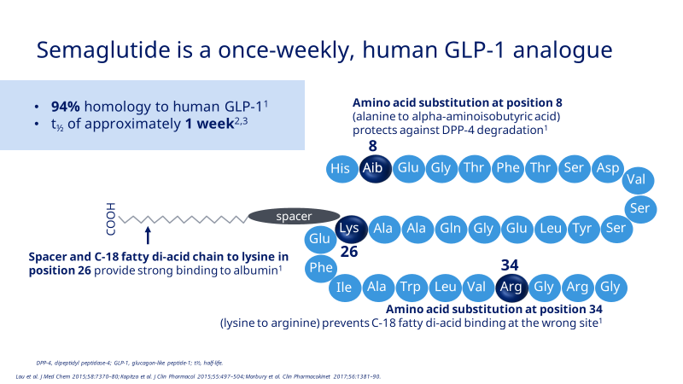
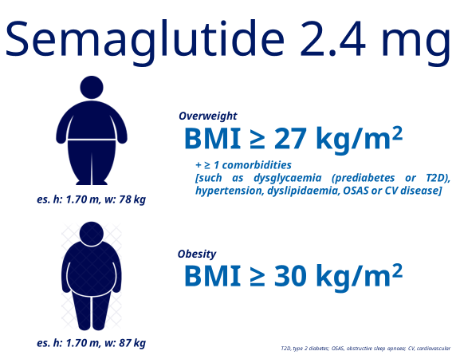
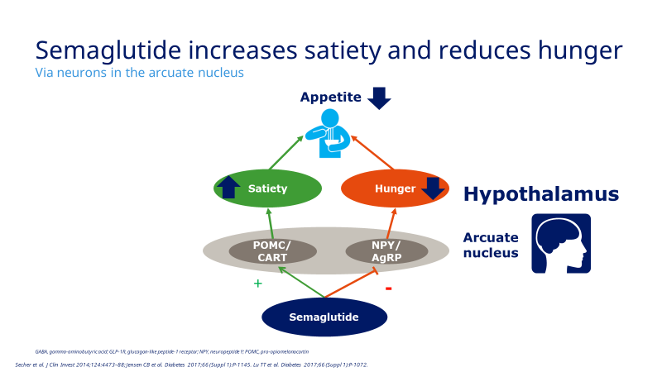
SmPC, available from https://www.aifa.gov.it/trova-farmaco

Slide 30
Organo adiposo come modulatore
dell’omeostasi energetica – ruolo della leptina
Drivers of dysfunction
• Nutrient excess
• Microbiome dysbiosis
• Adipocyte hypertrophy
• Visceral/ectopic fat expansion
• Hypoxia, ER/oxidative stress
Energy intake
Energy expenditure
MCR-4
Paraventricular Nucleus
(PVN)
Satiety
Hunger
POMC/ CART
NPY/ AgRP
Arcuate nucleus (ARC)
Agonisti recettoriali del GLP1
(Semaglutide)
Secher et al. J Clin Invest 2014;124:4473–88;
van Can et al. Int J Obes (Lond) 2014;38:784–93

Slide 31
Semaglutide 2.4 mg/settimana: efficacia sul calo di peso
STEP-1: Body weight change
Observed body weight change over time
(Mean at baseline: 105.8 kg)
Estimated change from baseline to week 68
-14.9%
-16.9%
ETD: -12.4 %-points 95% CI: [-13.4;-11.5]; p<0.0001
Semaglutide 2.4 mg
Placebo
ETD: -14.4 %-points 95% CI: [-15.3;-13.5]; p<0.0001
In-trial:
On-treatment:
Semaglutide 2.4 mg
Placebo
Treatment policy estimand:
Error bars are +/- standard error of the mean. CI, confidence interval; ETD, estimated treatment difference. Wilding JPH et al. NEJM 2021; doi: 10.1056/NEJMoa2032183. Online ahead of print.
Trial product estimand:
Notes:
References:
14.2.2 Body weight (kg) by week - descriptive statistics - in-trial - full analysis set
14.2.8 Body weight change from baseline by week - mean plot - treatment policy estimand - full analysis set, fmeanbwchbit. xlsx
14.2.19 Body weight change from baseline by week - mean plot - hypothetical estimand - full analysis set, fmeanbwchbot. xlsx
14.2.9 Body weight (%) change from baseline to week 68 - primary analysis - treatment policy estimand - full analysis set
14.2.10 Body weight (%) change from baseline to week 68 - bar plot - treatment policy estimand - full analysis set, fbarbwchbitpct.png
14.2.21 Body weight (%) change from baseline to week 68 - bar plot - hypothetical estimand - full analysis set, fbarbwchbotpct.png
14.2.20 Body weight (%) change from baseline to week 68 – statistical analysis – hypothetical estimand – full analysis set
The intention-to-treat principle defines that every patient randomized to the clinical study should enter the primary analysis. Accordingly, patients who drop out prematurely, are non-compliant to the study treatment, or even take the wrong study treatment, are included in the primary analysis within the respective treatment group they have been assigned to at randomization (“as randomized”).
While an analysis according to the ITT principle aims to preserve the original randomization and to avoid potential bias due to exclusion of patients, the aim of a per-protocol (PP) analysis is to identify a treatment effect which would occur under optimal conditions; i.e. to answer the question: what is the effect if patients are fully compliant? Therefore, some patients (from the full analysis set) need to be excluded from the population used for the PP analysis (PP population).

Slide 32
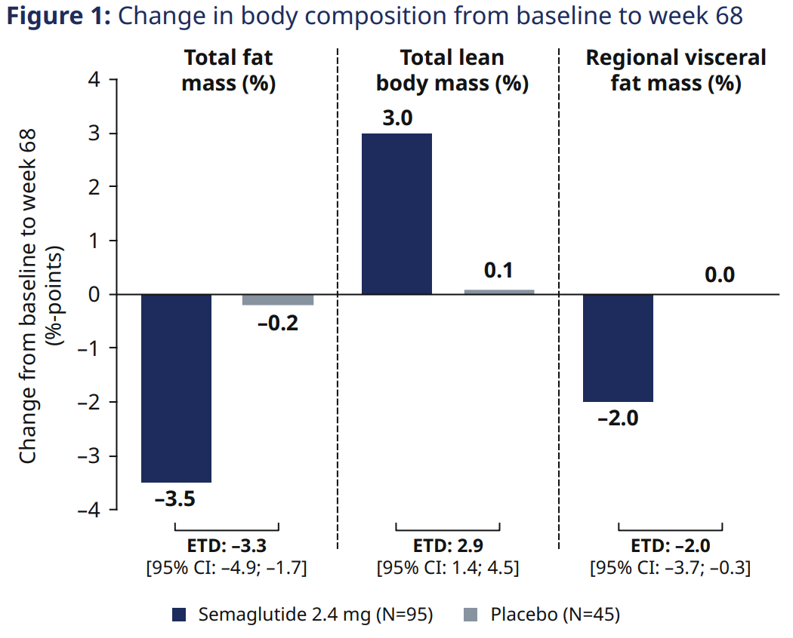
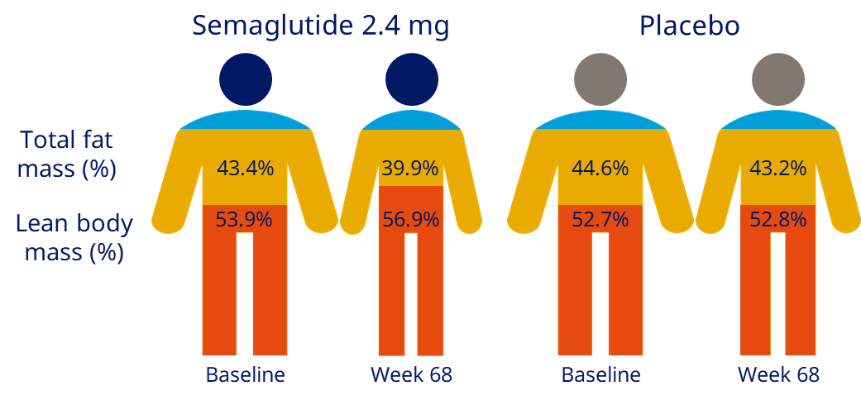
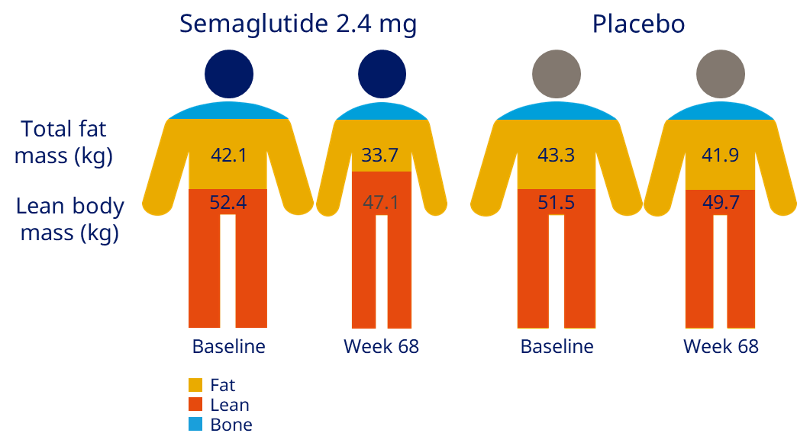
Semaglutide 2.4 mg/settimana: efficacia sulla massa grassa viscerale
Total fat mass decreased from BL by 19.3%, leading to 3.5%-point reduction relative to total body mass
Regional visceral fat mass decreased from BL by 27.4%, leading to 2.0%-point reduction relative to the area assessed*
Total lean body mass decreased from BL by 9.7%, leading to 3.0%-points increase relative to total body mass
Treatment policy estimand
L4 region (males or females)
android region (males only)
gynoid region (females only)
BL, baseline.
Adapted from Wilding et al. N Engl J Med 2021;384:989-1002. Supplementary appendix

Slide 33
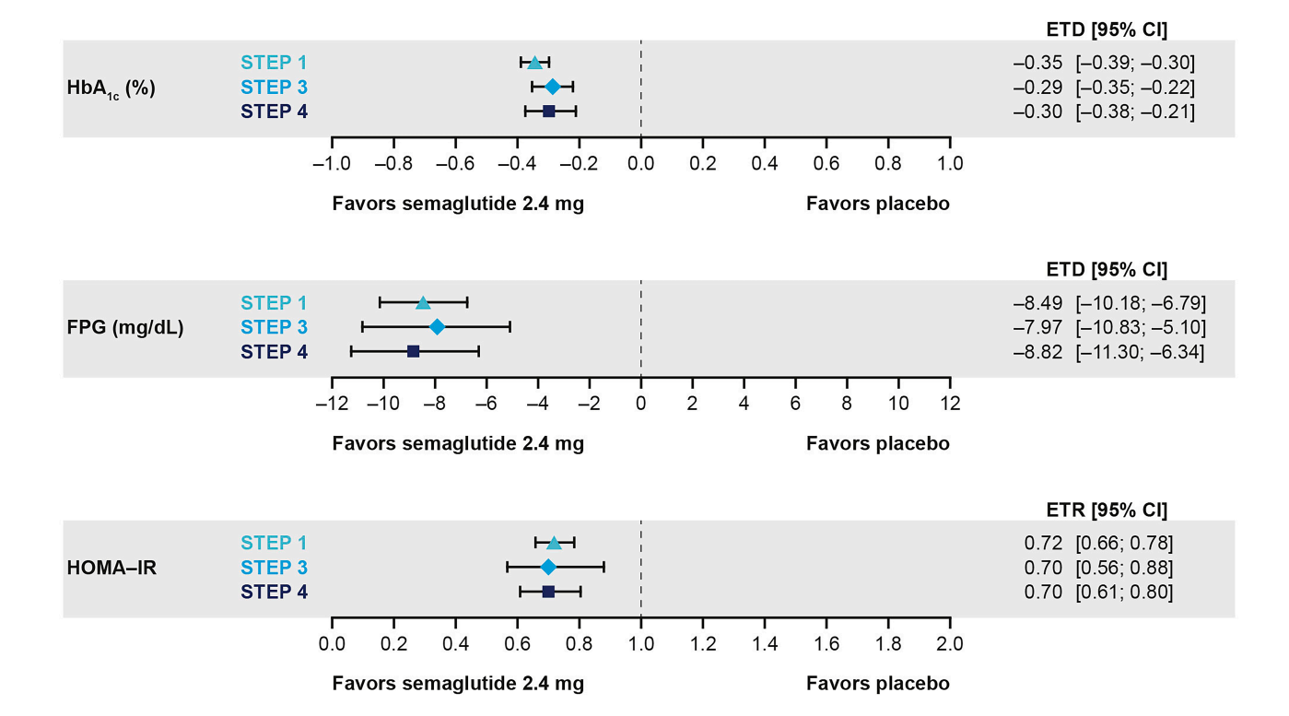
Decremento dell’insulino-resistenza negli studi STEP 1-3
Semaglutide 2.4 mg/settimana: efficacia sull’insulin-resistenza
Leigh Perreault, et al. Diabetes Care 1 October 2022; 45 (10): 2396–2405.

Slide 34
Decremento della PCR-HS negli studi STEP
Semaglutide 2.4 mg/settimana: efficacia sulla flogosi sistemica
STEP 1¹ | STEP 3³ | STEP 2² | STEP 5⁴ | STEP 8⁵ | STEP 6⁶
Weight management | Weight management with IBT | Weight management in T2D | 2-year effect of sema 2.4 mg | Weight management (vs. liraglutide 3.0 mg^) | East Asian trial
After 68 weeks
After 68 weeks
After 68 weeks
104 weeks
After 68 weeks
After 68 weeks
Semaglutide 2.4 mg
Liraglutide 3.0 mg
Placebo
Estimated change from baseline for treatment policy estimand. IBT, intensive behavioural therapy. 1. Wilding et al. N Engl J Med 2021; doi:10.1056/NEJMoa2032183; 2. Davies et al. Lancet, 2021; doi.org/10.1016/S0140-6736(21)00213-0: 3. Wadden et al. JAMA. doi:10.1001/jama.2021.1831; 4. Garvey et al. Presented at the 39th Annual Meeting of The Obesity Society (TOS) held at ObesityWeek®, virtual meeting, November 1–5, 2021; 5. Rubino et al. JAMA 2022; 327(2): 138-150;

Slide 35
^{Incidenza cumulativa dei MACE} SELECT: Primary cardiovascular composite endpoint
Semaglutide 2.4 mg/settimana: efficacia sui MACE
RCT su 17.604 paz. non diabetici
con BMI > 27 ed un pregresso evento CV
HR 0.80 (95% CI: 0.72; 0.90)
p<0.001 for superiority
20% reduction in risk of MACE*
Semaglutide 2.4 mg significantly reduced
the risk of MACE by 20% compared with placebo in people with obesity and established CVD, without T2D¹
Cumulative incidence (%)
All three components (death from CV causes, non-fatal MI and non-fatal stroke) contributed to MACE risk reduction
Months since randomisation
Mean follow-up time was 39.8 months
No. at risk
Semaglutide
Placebo
8,803
8,801
8,695
8,652
8,561
8,487
8,427
8,326
8,254
8,164
7,229
7,101
5,777
5,660
4,126
4,015
1,734
1,672
Semaglutide 2.4 mg
Placebo
Cumulative incidence (using the Aalen–Johansen method) of the composite MACE primary endpoint. The HR was estimated using a Cox proportional hazards regression model. The proportion of participants with MACE was 6.5% with semaglutide 2.4 mg and 8.0% with placebo. MACE was defined as death from CV causes, non-fatal myocardial infarction, or non-fatal stroke.
CI, confidence interval; HR, hazard ratio; MACE, major adverse cardiovascular events; MI, myocardial infarction.
Lincoff AM et al. N Engl J Med 2023;DOI:10.1056/NEJMoa2307563;

Slide 36
Agenda
Dall’organo adiposo all’ABCD alla PCOS & Infertilità
Curare l’ABCD con gli agonisti recettoriali del GLP-1
Curare la PCOS & l’infertilità con gli agonisti recettoriali del GLP-1

Slide 37
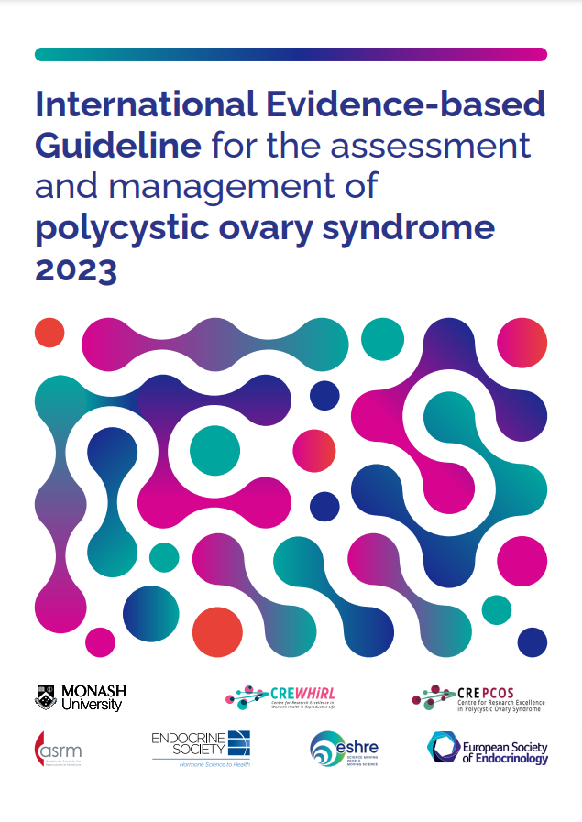
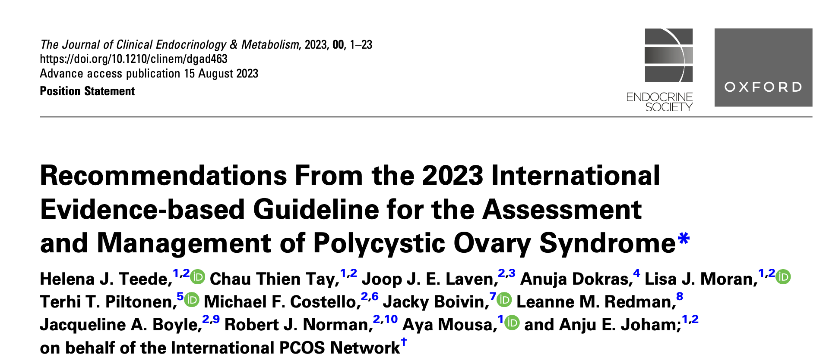
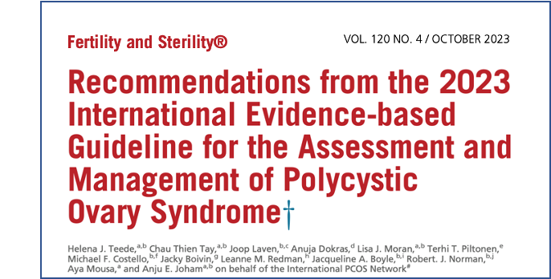
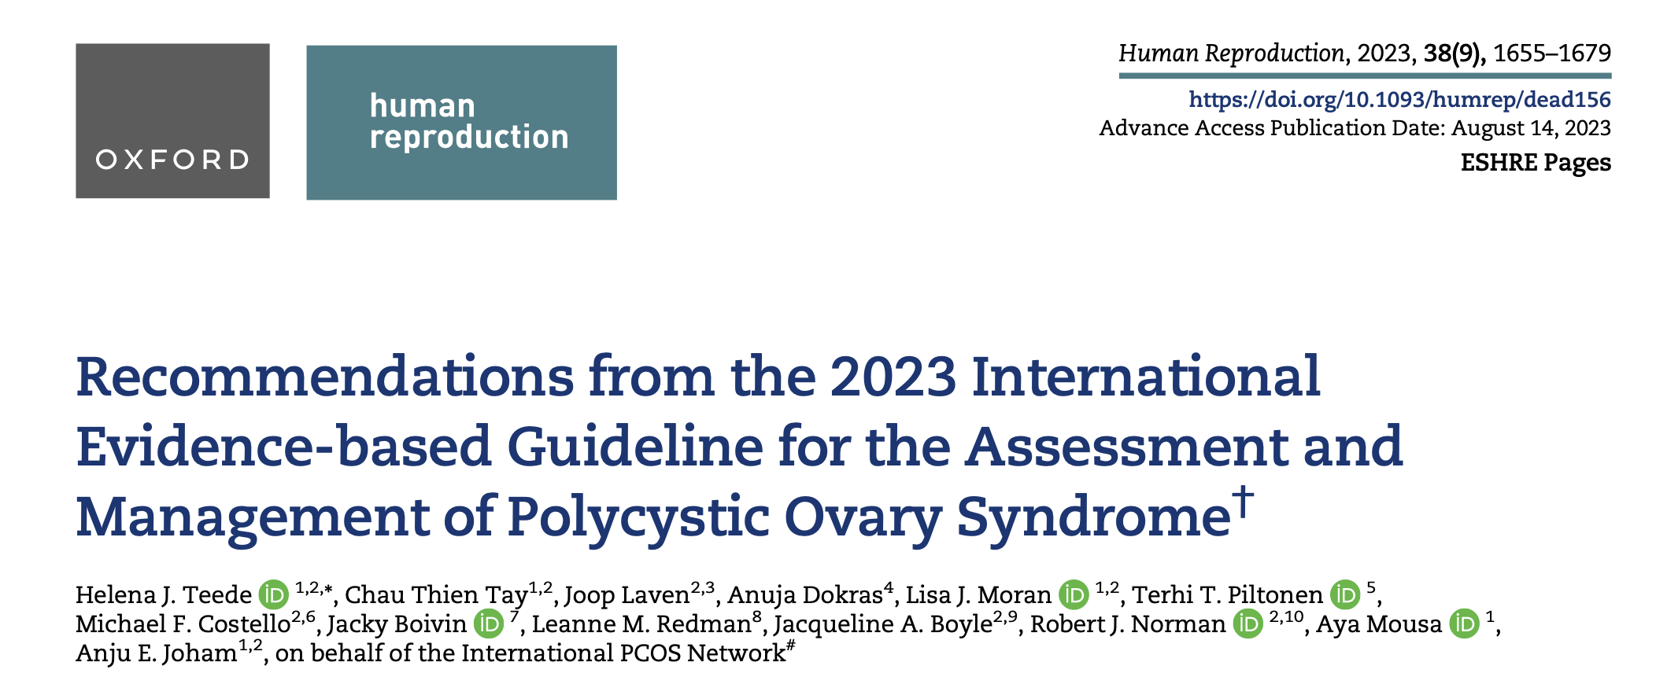
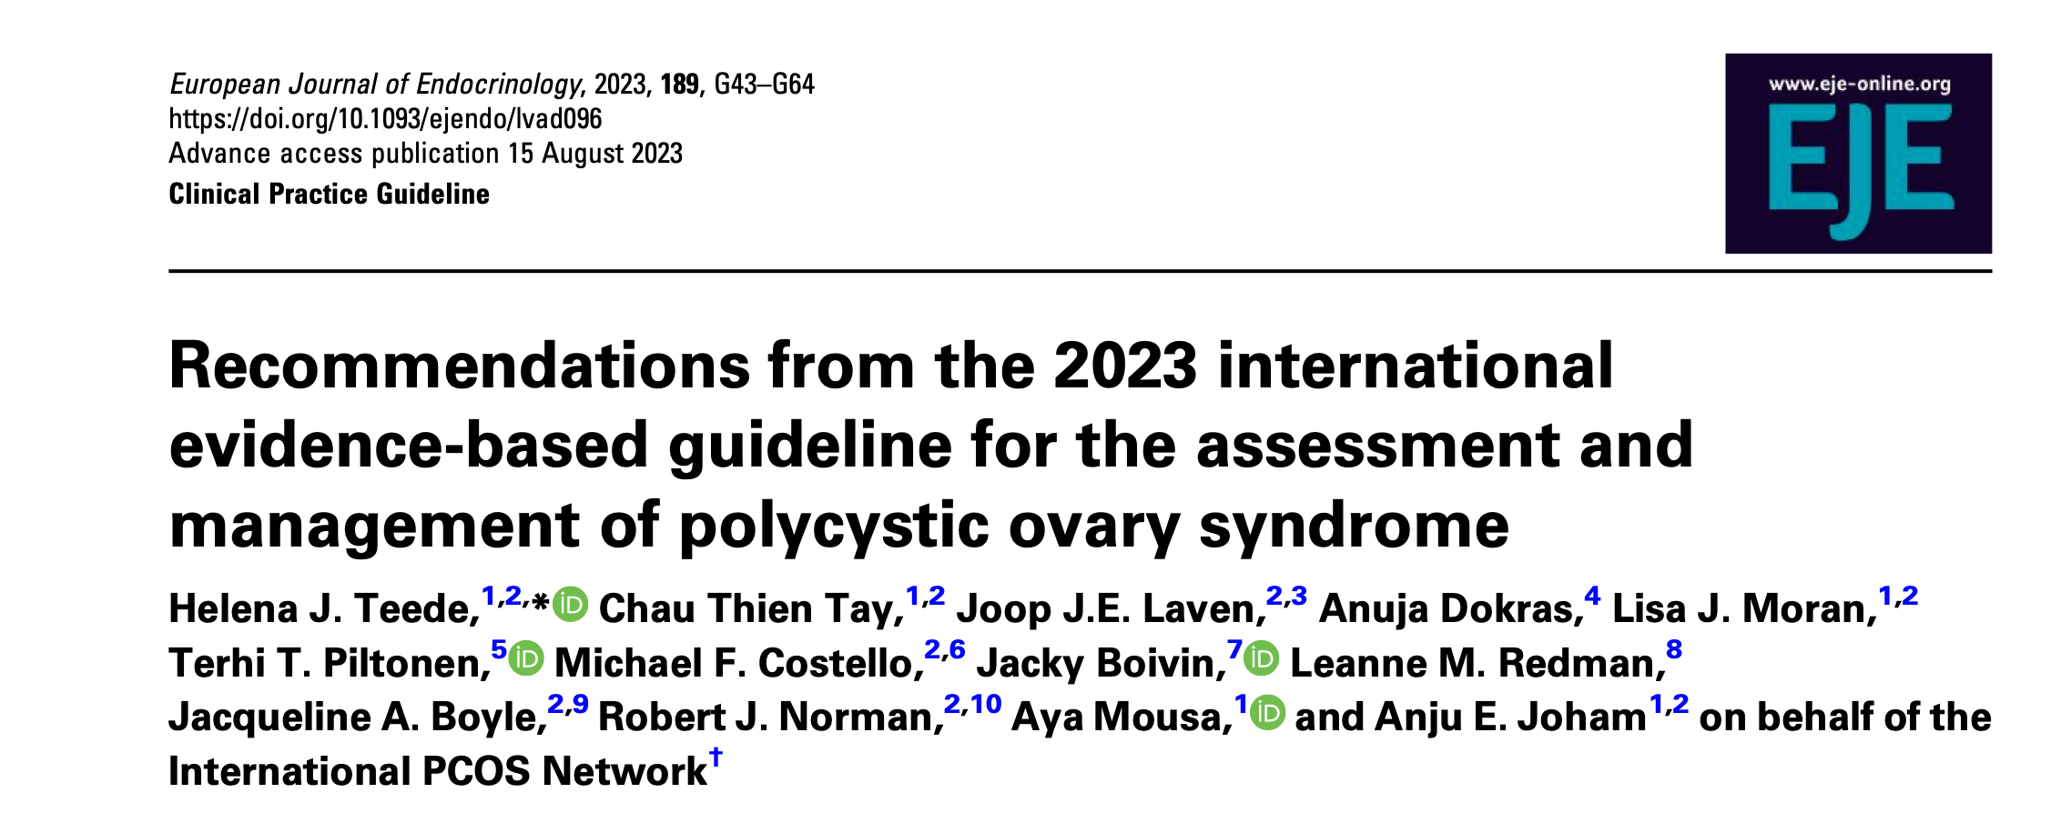

Slide 38
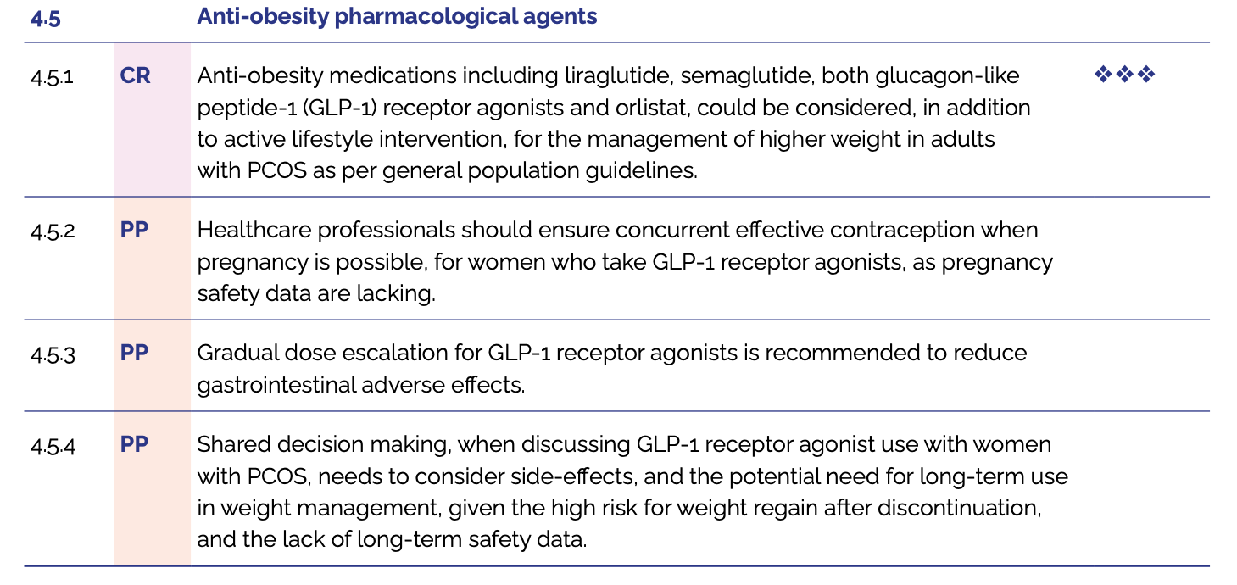
Linee Guida 2023. Gestione delle caratteristiche non correlate alla fertilità
https://www.monash.edu/__data/assets/pdf_file/0003/3371133/PCOS-Guideline-Summary-2023.pdf

Slide 39
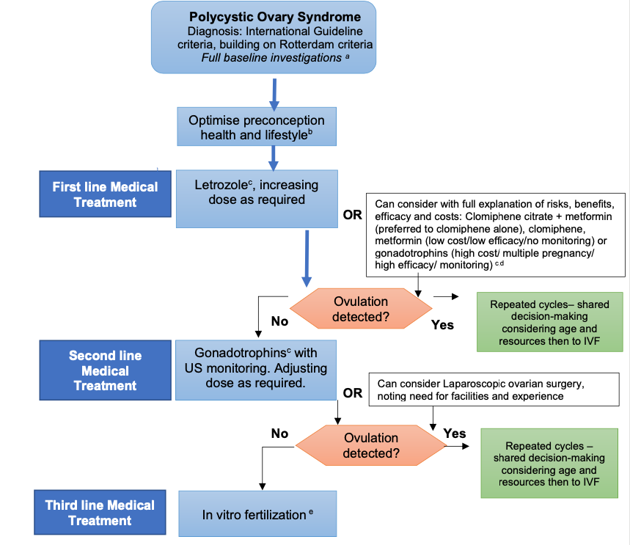
Linee Guida 2023. Algoritmo infertilità per la PCOS
Baseline investigations: i. Diagnosis of PCOS - Endocrine profile and pelvic ultrasound scan ii. Assessment of BMI, BP & glycemic status (OGTT / HbA1c) iii. Routine preconception assessments (Rubella immunity, infection screen etc..), advice and supplementation. iv. Additional investigations: semen analysis and consider tubal patency assessment
Healthy lifestyle encompassing healthy eating and regular physical activity should be recommended in all those with PCOS to limit adverse impacts on fertility and fertility treatment outcomes and to optimize health during pregnancy
Off label prescribing: Letrozole, metformin and other pharmacological treatments are generally off label in PCOS, as pharmaceutical companies have not applied for approval in this condition. However, recommended off label use is evidence-based and allowed in many countries. Where it is allowed, health professionals should inform women and discuss the evidence, possible concerns and side effects of treatment.
Compared to letrozole, metformin has lower efficacy, cost and multiple pregnancy rate and gonadotrophins have higher efficacy, cost and multiple pregnancy rate. Both may be an alternative first line choice for informed women.
In vitro fertilization (IVF) - Third line unless other infertility factors (e.g. male, tubal). PCOS specific protocols to minimise risk of ovarian hyperstimulation syndrome, consider invitro maturation if available.
Teede HJ, et al. J Clin Endocrinol Metab. 2023 Sep 18;108(10):2447-2469

Slide 40
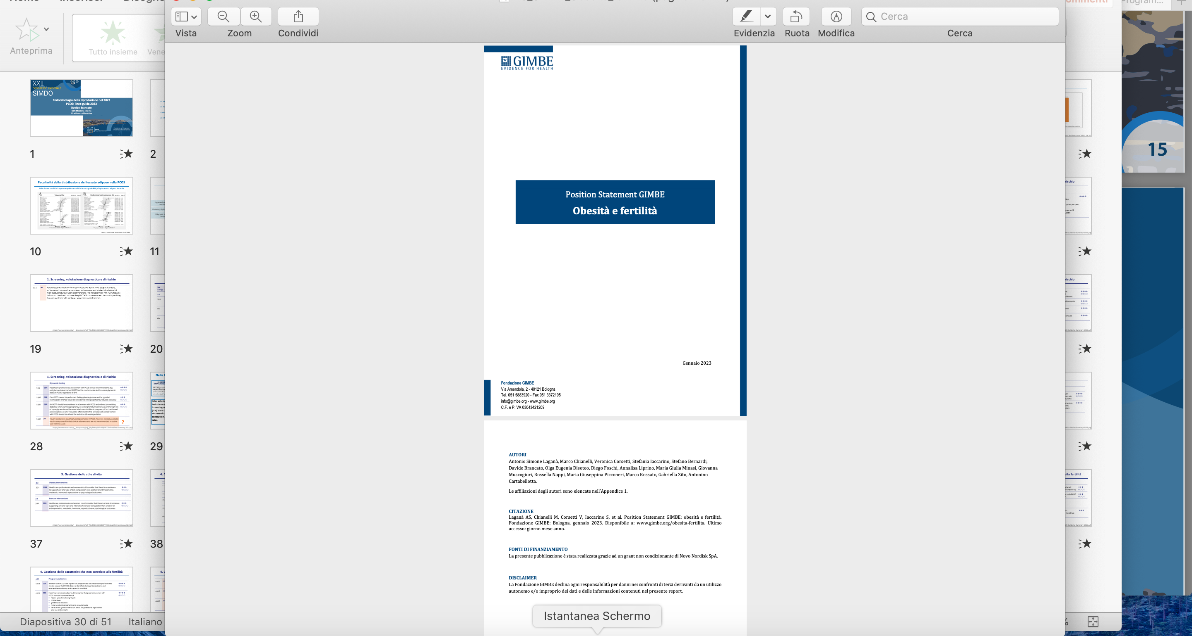
GIMBE 2023. Gestione dell’obesità in ginecologia della riproduzione

Slide 41
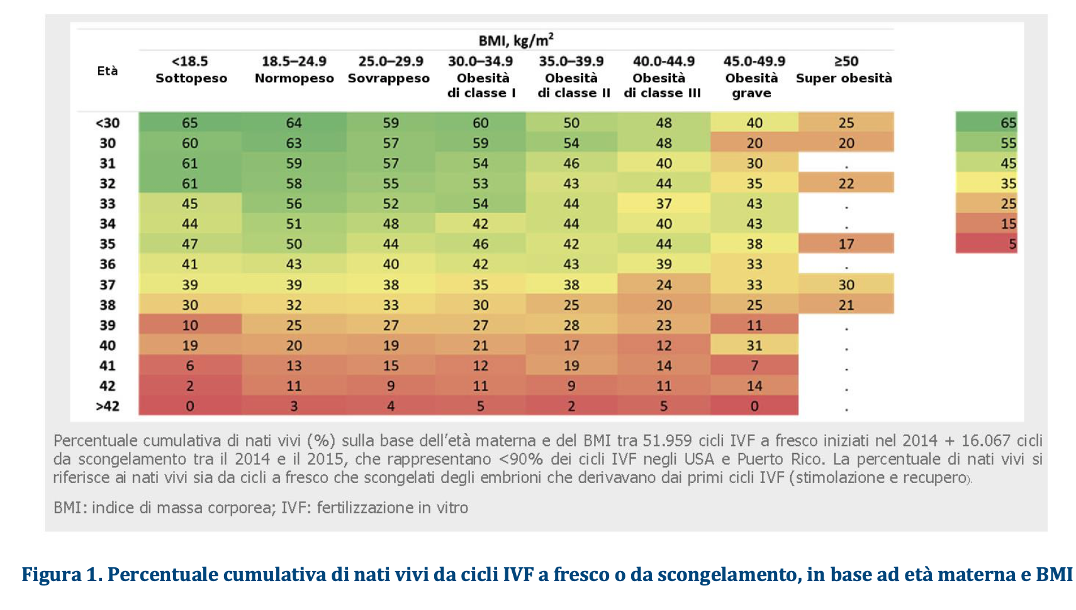
GIMBE 2023. Il ruolo del BMI nel tasso di nati vivi da IFV

Slide 42
GIMBE 2023. Consensus
Nelle donne anovulatorie con obesità, gli interventi di perdita di peso migliorano il tasso di concepimento non associato a PMA e il tasso di ovulazione in risposta all’induzione dell’ovulazione nella PMA, ma non il LBR.
Nelle donne ovulatorie con obesità, gli interventi di perdita di peso pre-gravidanza non hanno dimostrato di migliorare il LBR, con o senza IVF.
La chirurgia bariatrica è indicata solo in caso di fallimento delle misure terapeutiche dietetico- comportamentali e farmacologiche

Slide 43
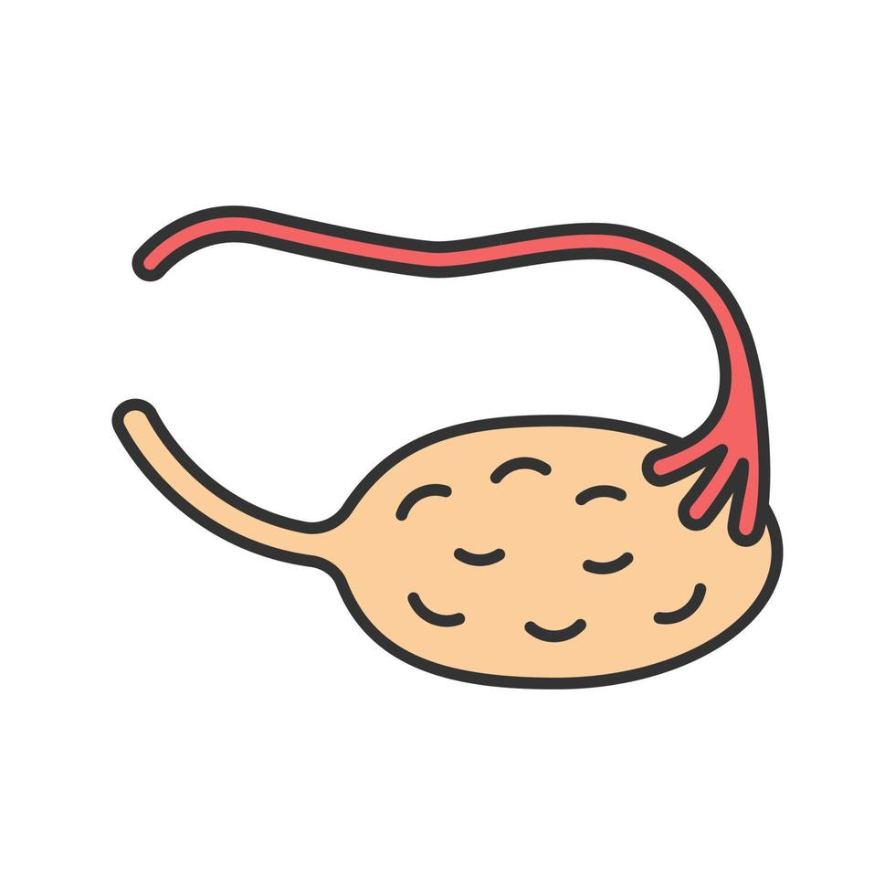
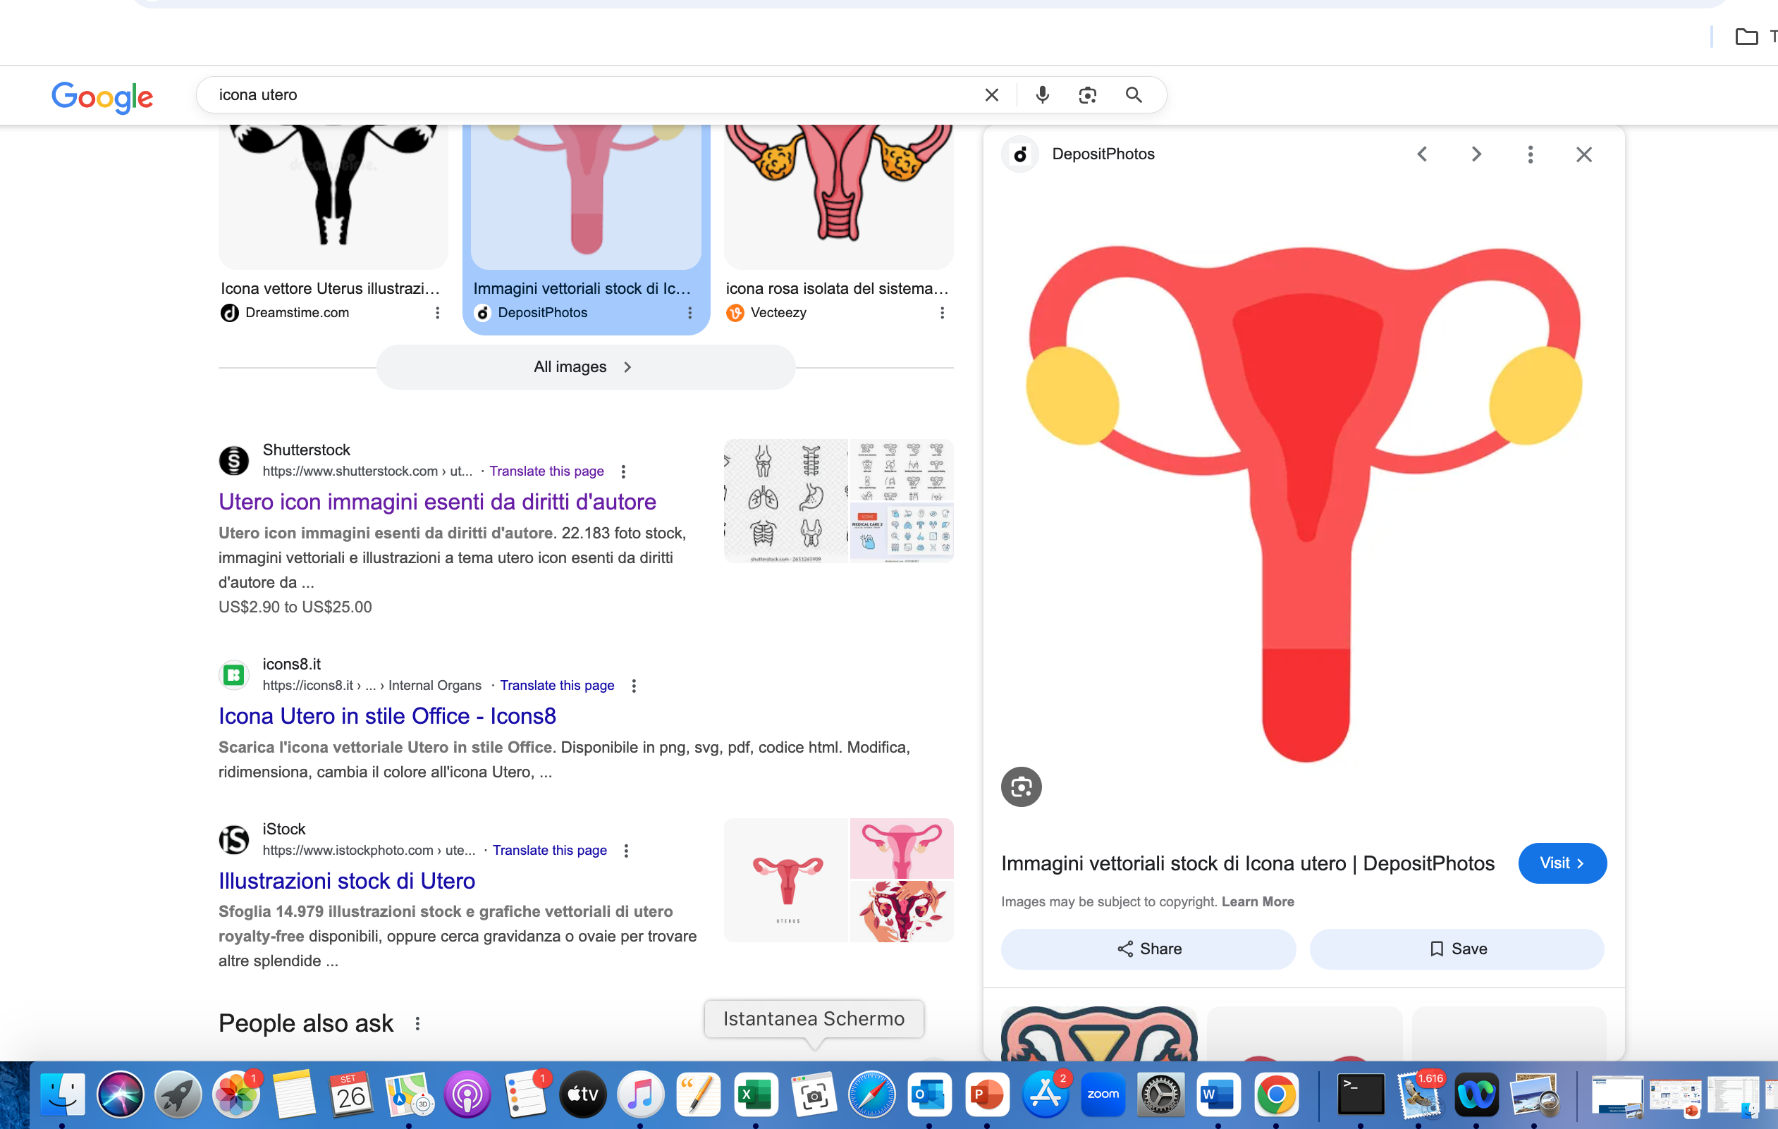
Potenziale ruolo degli agonisti recettoriali del GLP1 nella cura
della PCOS & infertilità
GLP-1 RA
💉
HPO axis
GnRH pulse generator
↓ Weight ↓ IR ↓ Inflammation
Ovary ↓ Androgens ↑ Follicles
🧠
Endometrium ↑ Receptivity?
Lin J, et al. Sci Rep. 2025.
Sridharan K, Diabetol Metab Syndr. 2025.
Chen L, et al. Reprod Biol Endocrinol. 2025.
Szczesnowicz D, et al. Int J Mol Sci. 2023.
Sánchez-Garrido MA, et al. Nat Commun. 2024.
Merhi Z, et al. J Clin Endocrinol Metab. 2025
👶
↑ Ovulation ↑ Fertility

Slide 44
Agonisti recettoriali del GLP1 nella cura della PCOS: quali evidenze ?
Metanalisi 2025 di 13 RCT pubblicati dal 2008 al 2022
Study (year) | Study design | N (GLP‑1RA) | N (Control) | BMI (kg/m²) | GLP‑1RA used | Intervention (GLP‑1RA vs Control) | Duration
Elkind‑Hirsch 2008 | Open‑label prospective RCT | 20 | 20 | 39.9 ± 1.5 | Exenatide | Exenatide 10 µg BID vs Metformin 1000 mg BID | 24 weeks
Elkind‑Hirsch 2022 | Double‑blind, placebo‑controlled RCT | 44 | 23 | 41.6 ± 1.1 | Liraglutide | Liraglutide 3 mg QD vs Placebo | 32 weeks
Frossing 2018 | Double‑blind, placebo‑controlled RCT | 48 | 24 | 33.3 ± 5.1 | Liraglutide | Liraglutide 1.8 mg QD vs Placebo | 26 weeks
Jensterle 2014 | Open‑label prospective RCT | 11 | 14 | 39.3 ± 4.2 | Liraglutide | Liraglutide 1.2 mg QD + Metformin 1000 mg BID vs Metformin 1000 mg BID | 12 weeks
Jensterle 2015 | Open‑label prospective RCT | 14 | 13 | 36.7 ± 5.6 | Liraglutide | Liraglutide 1.2 mg QD + Metformin 1000 mg BID vs Metformin 1000 mg BID | 12 weeks
Jensterle 2015a | Open‑label prospective RCT | 14 | 14 | 40.8 ± 6.1 | Liraglutide | Liraglutide 1.2 mg QD + Metformin 1000 mg BID vs Metformin 1000 mg BID | 12 weeks
Jensterle 2021 | Single‑blind, placebo‑controlled RCT | 13 | 12 | 36.8 ± 3.9 | Semaglutide | Semaglutide 0.5 mg/week vs Placebo | 16 weeks
Jensterle 2022 | Single‑blind, placebo‑controlled RCT | 10 | 9 | 37.9 (33.2–41.4) | Semaglutide | Semaglutide 1 mg/week vs Placebo | 12 weeks
Li 2022 | Open‑label prospective RCT | 72 | 75 | 29.07 ± 3.92 | Exenatide | Exenatide 10 µg BID vs Metformin 1000 mg BID | 12 weeks
Liu 2017 | Open‑label prospective RCT | 78 | 80 | 29.16 ± 3.11 | Exenatide | Exenatide 10 µg BID vs Metformin 1000 mg BID | 24 weeks
Nylander 2017 | Double‑blind, placebo‑controlled RCT | 47 | 23 | 33.3 ± 5.1 | Exenatide | Exenatide 10 µg BID + Metformin 1000 mg BID vs Placebo + Metformin 1000 mg BID | 12 weeks
Tao 2021 | Open‑label prospective RCT | 50 | 50 | 30.99 (27.84–33.34) | Exenatide | Exenatide 10 µg BID vs Metformin 1000 mg BID | 12 weeks
Zheng 2017 | Open‑label prospective RCT | 41 | 41 | 29.18 ± 4.15 | Exenatide | Exenatide 10 µg BID vs Metformin 1000 mg BID | 12 weeks
Lin, S.,et al. Sci Rep 15, 16512 (2025).

Slide 45
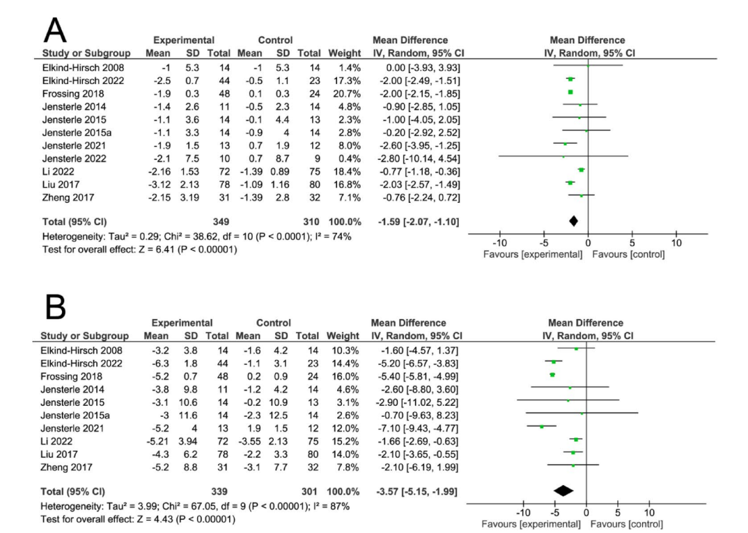
Agonisti recettoriali del GLP1 nella cura della PCOS: quali evidenze ?
Metanalisi 2025 di 13 RCT studi pubblicati dal 2008 al 2022
Body Weight
Waist Circumference
Lin, S., et al. Sci Rep 15, 16512 (2025).

Slide 46
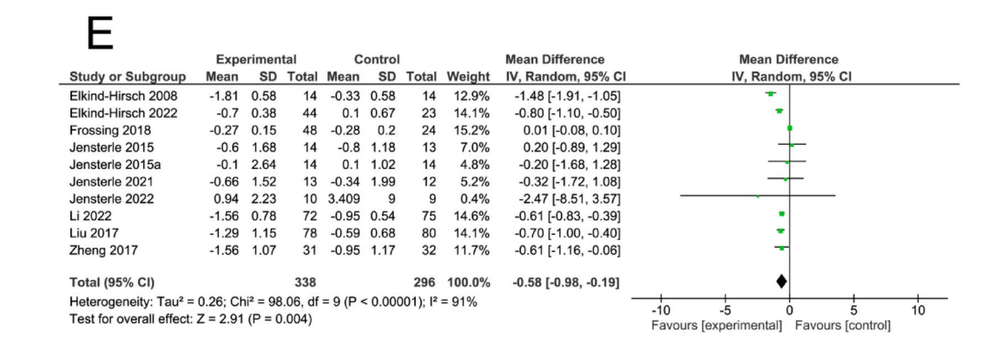
Agonisti recettoriali del GLP1 nella cura della PCOS: quali evidenze ?
Metanalisi 2025 di 13 RCT studi pubblicati dal 2008 al 2022
HOMA-IR
Lin, S., et al. Sci Rep 15, 16512 (2025).

Slide 47
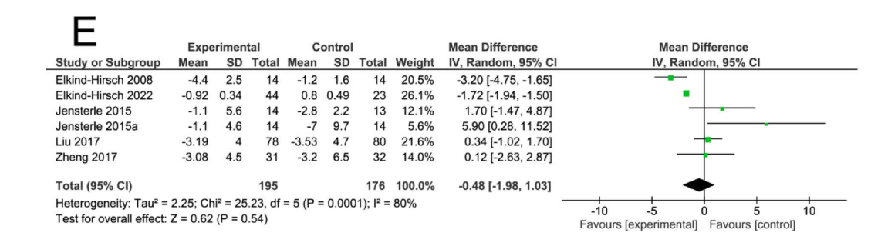
Agonisti recettoriali del GLP1 nella cura della PCOS: quali evidenze ?
Metanalisi 2025 di 13 RCT studi pubblicati dal 2008 al 2022
Free Androgen Index
Lin, S., et al. Sci Rep 15, 16512 (2025).

Slide 48
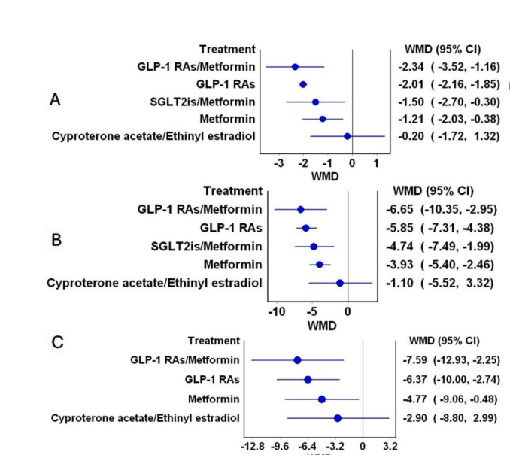
Agonisti recettoriali del GLP1 nella cura della PCOS: quali evidenze ?
Metanalisi 2025 di 27 RCT (1642 pz.)
Weight
Waist circumference
Fat mass
Sridharan, K., et al. Diabetol Metab Syndr 17, 168 (2025).

Slide 49
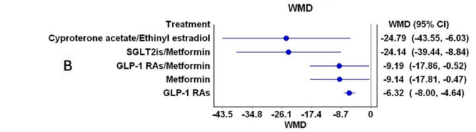
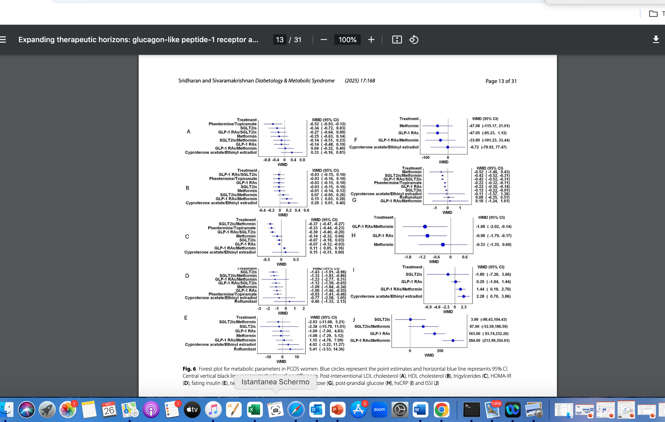
Agonisti recettoriali del GLP1 nella cura della PCOS: quali evidenze ?
Metanalisi 2025 di 27 RCT (1642 pz.)
Total Testosterone
SHBG
Sridharan, K., et al. Diabetol Metab Syndr 17, 168 (2025).

Slide 50
Agonisti recettoriali del GLP1 nella cura della PCOS: quali evidenze ?
Metanalisi 2025 di 27 RCT (1642 pz.)
HOMA-IR
CRP-HS
Sridharan, K., et al. Diabetol Metab Syndr 17, 168 (2025).

Slide 51
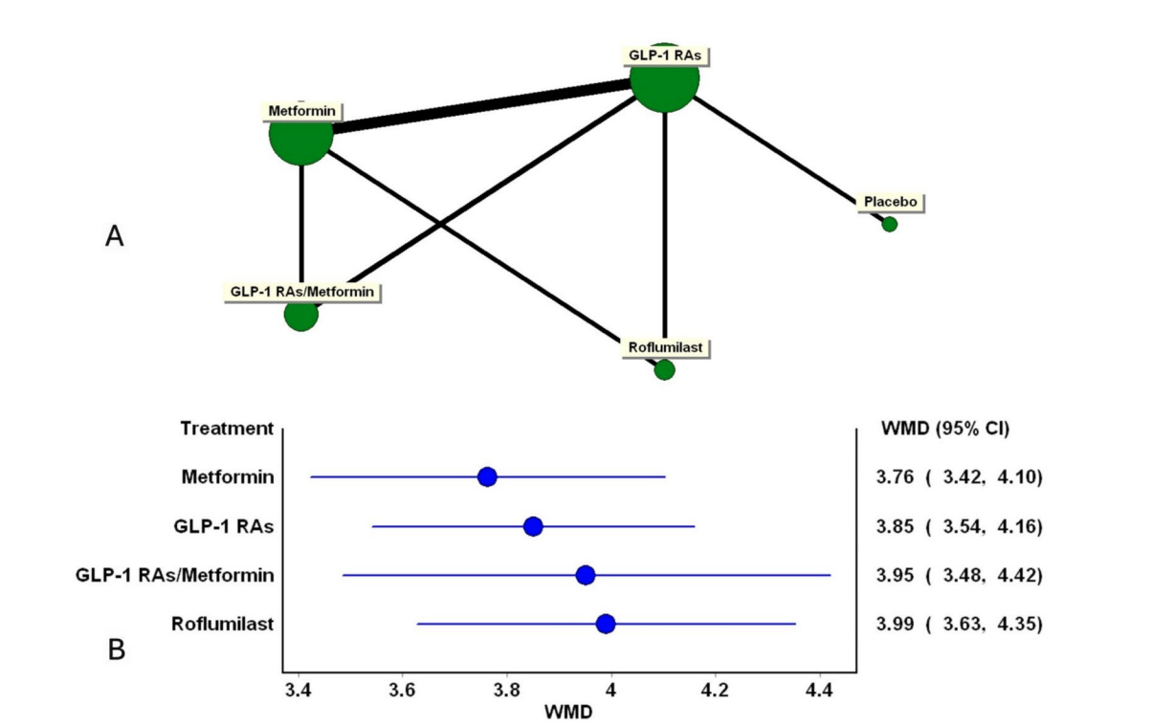
Agonisti recettoriali del GLP1 nella cura della PCOS: quali evidenze ?
Metanalisi 2025 di 27 RCT (1642 pz.)
Mestrual frequency
Sridharan, K., et al. Diabetol Metab Syndr 17, 168 (2025).

Slide 52
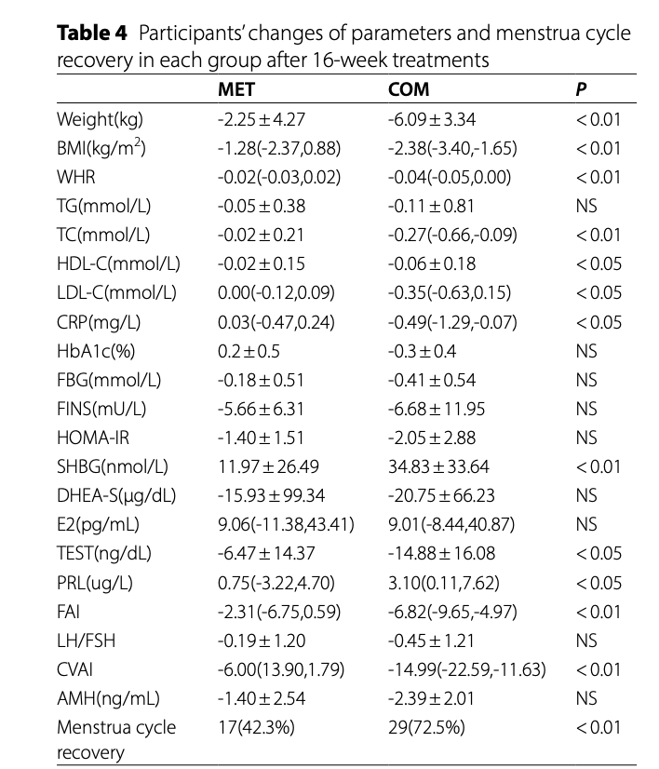
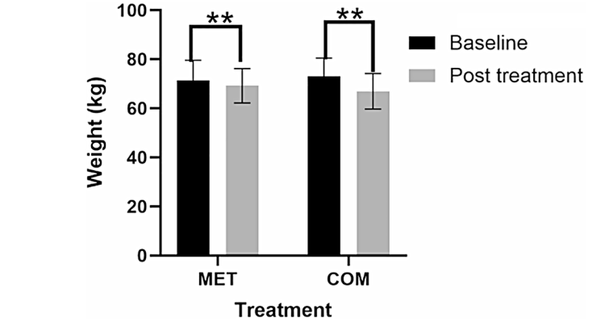
Agonisti recettoriali del GLP1 nella cura della PCOS: semaglutide
RCT 2025 – 100 pazienti – 16 settimane –
Semaglutide + Metformina 1 mg/sett vs Metformina 1000 mg x 2
Chen, H., et al. Reprod Biol Endocrinol 23, 108 (2025).

Slide 53
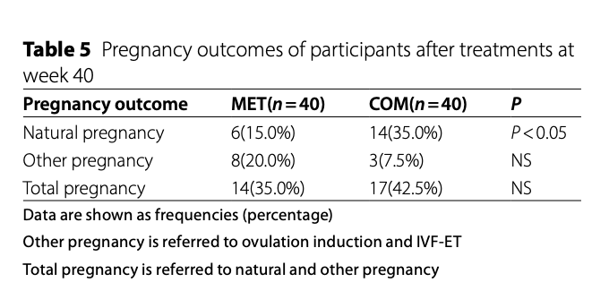
Agonisti recettoriali del GLP1 nella cura della PCOS: semaglutide
RCT 2025 – 100 pazienti – 16 settimane –
Semaglutide + Metformina 1 mg/sett vs Metformina 1000 mg x 2
Chen, H., et al. Reprod Biol Endocrinol 23, 108 (2025).

Slide 54
THM
La terapia farmacologica dell’obesità è raccomandata dal SNLG 2025 nei soggetti con BMI 30-40 kg/mt2 ed in quelli con BMI 27-30/mt2 se presenti comorbidità, quindi le donne con PCOS/infertilità
Vi sono solide prove di di evidenza che gli agonisti recettoriali del GLP1 determinano, nelle donne con ABCD complicata da PCOS/infertilità, un beneficio in termini di massa, distribuzione e disfunzione endocrinologica (HOMA-IR, FAI) e immunologico-infiammatoria (CRP-hs) consentendo un incremento del tasso di fertilità, soprattutto in contesto non-PMA
In tale contesto, semaglutide sembra mostrare le evidenze più solide
Ulteriori studi sono necessari per valutare efficacia e sicurezza, soprattutto nell’ambito della PMA

